Slide 1










Launching Biomedical Innovators: Day 2
June 21, 2023

Slide 2

Small
Business Program
Jessica Forbes, Ph.D., CCC-SLP
AAAS Science and Technology Policy Fellow
NINDS Small Business Program
Division of Translational Research, NINDS
Jessica.Forbes@nih.gov

Slide 3
NINDS Mission
The NINDS mission space encompasses hundreds of neurological disorders
Pain
Stroke
Seek fundamental knowledge about the brain and nervous system and use that knowledge to reduce the burden of neurological disease for all people.
Epilepsy
Spinal Cord Injury
Traumatic Brain Injury
Neurogenetic Disorders
Neurodegenerative Disorders

Slide 4
Small Business Portfolio
Therapeutics
Diagnostics
Devices
Biologics
Research Tools
Biomarkers
Small
Molecules
Drug
Discovery
Device
Prototyping
Preclinical
Validation
IND&IDE
Enabling Research
Human Subjects
Research
Early-Stage
Clinical
Trials
Broad Range
of Translational
Research and Development
Activities

Slide 5
SBIR/STTR Funding Opportunities
Omnibus FOA
Investigator-Initiated projects within NINDS mission
PA-22-177 (SBIR), PA-21-262 (STTR)
NINDS accepts NON-CT Phase I, Phase II, D2PII, and Fast-Track apps to Omnibus
Specific Technical Focus or Initiative
Research Tools (BRAIN Initiative)
NOT-MH-21-125
Pain Management
(HEAL Initiative)
RFA-NS-23-007 (STTR, No CT)
RFA-NS-23-006 (SBIR, No CT)
AD/ADRD
PAS-22-197 (STTR)
PAS-22-196 (SBIR)
Later Stage Activities
Exploratory Clinical Trials
PAR-21-267 (STTR)
PAR-21-266 (SBIR)
Phase IIb SBIR
PAR-21-114 (pre-clinical)
PAR-21-265 (clinical research and clinical trials)
Most opportunities have standard SBIR/STTR due dates (Jan 5th, April 5th, Sept 5th )

Slide 6
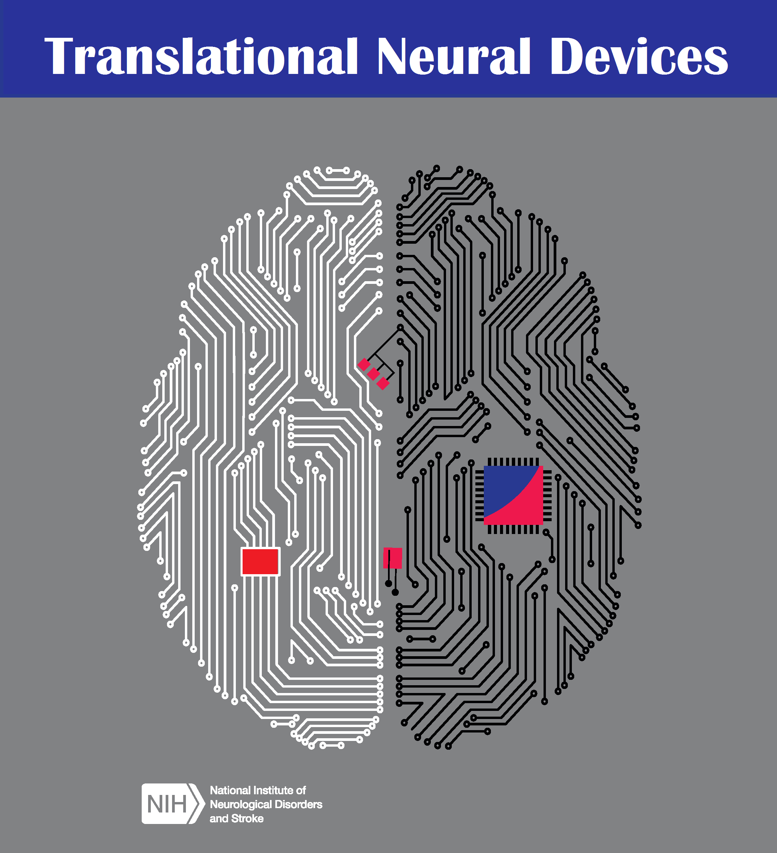



SBIR/STTR Cooperative Agreement
Funding Opportunities (U44)
Devices:
Translational Neural Devices:
RFA-NS-21-022
Contact: Nick Langhals,
nick.langhals@nih.gov
Small Molecules:
Blueprint Neurotherapeutics:
PAR-20-111
Contact: Chuck Cywin,
charles.cywin@nih.gov
Biomarkers:
Biomarkers: PAR-21-059 and PAR-21-057
Contact Carol Taylor-Burds, carol.taylor-burds@nih.gov
Clinical Trial Networks:
NeuroNEXT: PAR-21-224,
Contact Codrin Lungu
lunguci@ninds.nih.gov
Many of these opportunities have NON-STANDARD SBIR/STTR due dates CONTACT PROGRAM STAFF

Slide 7
Small Business Program Phases
PHASE I
Phase II
Feasibility
Technical Merit
Commercial Potential of your research project
*Preliminary data is not required, but helpful
Let's you continue R&D from Phase I.
Must do a phase I to apply for Phase II.
Once you reach your Phase I milestones, you can apply for phase II
Fast Track
Direct-to-Phase II
SBIR Only
Phase IIB
CRP Program
Submit Phase I & Phase II in one application for review
Requires a fully developed Phase II application/ commercialization plan at the time of submission
NINDS offers Phase IIB awards for Phase II projects that require extraordinary time and effort beyond the standard Phase II period of 2 years.
Commercialization Readiness Pilot Program
If your project has already demonstrated Phase 1 equivalent feasibility, you can apply for a Direct to Phase II award and bypass Phase I.
.
Provides awarded Phase II or Phase IIB small businesses technical assistance and funding for late-stage development.

Slide 8
Application Due Dates & Process
September 5
January 5
April 5
STEP 1
STEP 3
STEP 5
Submission
of Application
Scientific Review
Award
3
Months
3
Months or more
2 Weeks
3
Months
STEP 2
STEP 4
Institute and Review Assignments
Council Review

Slide 9

Review Criteria
Significance
Investigators
Does the product address a significant problem and have commercial potential?
Is there a realistic market for the proposed product?
01
04
Does the team have the appropriate training and expertise to complete the project?
Approach
Environment
02
05
Are design and methods well developed and appropriate?
Are potential pitfalls and alternative approaches provided?
Does the scientific environment contribute to the probability of success?
Are there appropriate facilities and equipment to conduct the studies?
Innovation
03
06
Commercialization
How novel are the technology/product and the approaches proposed to test feasibility?
Does the product fill a significant market gap?
Does the company’s business strategy have a high potential for success?

Slide 10
Importance of Rigor and Reproducibility
Rigor of Prior Research
Scientific Rigor (Design)
Biological Variables
Authentication
Describe the strengths and weaknesses of prior research
Apply a robust and unbiased experimental design, methodology, analysis, interpretation, and reporting of results
*Significance & Approach
*Approach
Sex, age, weight, and underlying health conditions will affect health or disease.
** Especially in animal study designs
How are you showing the reagents can do what you are saying it can?
Include cell lines, specialty chemicals, antibodies, and other biologics
*Approach
*Include as an attachment

Slide 11
Commercialization Plan Pointers
Value of the Project
Company Overview
Market, Customer & Competition
Intellectual Property Protection
Finance Plan
Production & Marketing Plan
Commercial and societal benefits
Competitive advantage over existing technology
Relevant commercialization capabilities of your team
Product lines that show successful market implementation
Know your market and market needs
Identify main customer bases
Know your competition
List current patents or describe how the company plans to protect the IP
Letter of commitment of funding
Letter of support for the project
Product
Place
(Channels of Distribution)
Promotion
(Communications Strategy)
Pricing

Slide 12
Budget Limits
Phase
I
$700K
$500K
6-24 months
Total
Funding Support
Max Funding Support/ Year
Duration
Phase
II
$3 Million
$1.5 Million
12-36 months
Award amounts reflect SBA-approved hard cap waiver. Applies to only specific topics

Slide 13
SBA Approved Waiver Topics
In vivo animal testing required for therapeutics and diagnostics development
Drug and biologics preclinical discovery and development activities for regulatory submissions (e.g., lead identification/optimization, preclinical efficacy testing, IND-enabling studies, and manufacturing for clinical trials).
Device preclinical discovery and development activities for regulatory submission
(e.g., hardware prototyping, device/software verification, biocompatibility/sterilization testing, pre-clinical efficacy testing, large animal GLP safety testing, and preparing material/devices for human testing).
Clinical testing of therapeutics (drugs, devices, or biologics), diagnostics, clinical and rehabilitation tools (e.g., intraoperative technologies, rehabilitation devices and programs, and brain monitoring systems), and technologies for clinical research).
In vivo animal testing of technologies for animal research and development of animal models for drug development and neuroscience research.
Research that requires special facilities to contain hazardous or infectious materials.
Development and validation of biomarkers and the technologies and approaches for measuring them. Biomarkers may include diagnostic, prognostic, monitoring, pharmacodynamic/response, risk, safety, and predictive biomarkers.

Slide 14
Programs for
First-Time Small Business Applicants
Applicant Assistance Program &
Health Disparities Pre-Application Program

Slide 15
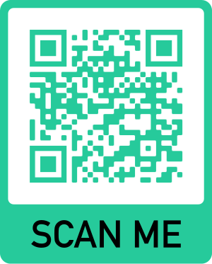
NIH Applicant Assistance Program
​
AAP PROVIDES | AAP DOES NOT PROVIDE
Phase I SBIR/STTR application preparation support and review | Grant writer
Specific Aims page review and advice | Research plan development
Submission process coaching | Small business registration or NIH application submission services
FREE application preparation
assistance program
10 weeks in length (virtual)
PROGRAM GOAL
Guide through one-on-one coaching for applicants with great technology but little NIH experience
Eligibility
No previous SBIR/STTR awards granted
Women and underrepresented individuals in biosciences are encouraged to apply!
Notes:
First I’d like to discuss the NIH Applicant Assistance Program
The NIH grant application process can be complex and overwhelming, especially for first time applicants
The AAP is designed to assist small businesses in preparing a Phase I application for the Small Business Innovation Research (SBIR) and Small Business Technology Transfer (STTR) programs.
The goal of the AAP program is to increase the number of small business applications and to ensure that the applications are free from errors or omissions and are deemed complete, compliant, and responsive to the announcement criteria for review
The AAP has 3 cycles per year and each cycle leads up to each of the small business funding cycles.
The 3 Institutes that are represented here at the conference are participating in the AAP.
AAP provides participants: with coaching and mentoring, assistance with application support & reports along with assistance with required registrations
It is Important to clarify that the program does not provide grant writing assistance or research plan development. Also, participants are required to submit their own grant application.

Slide 16
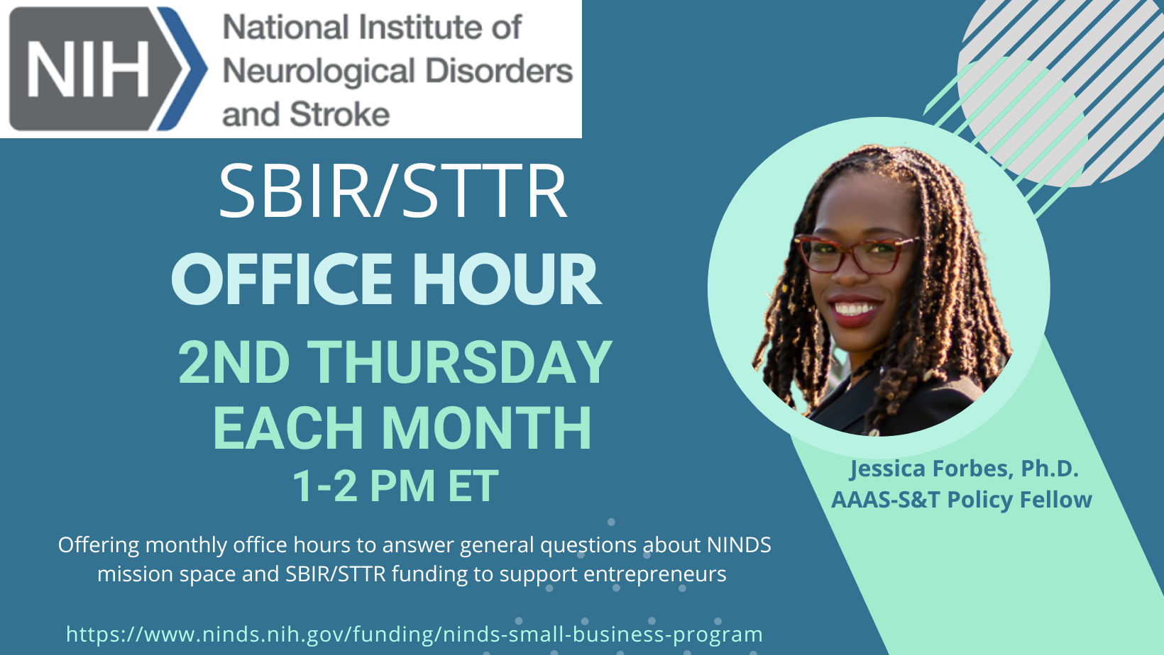
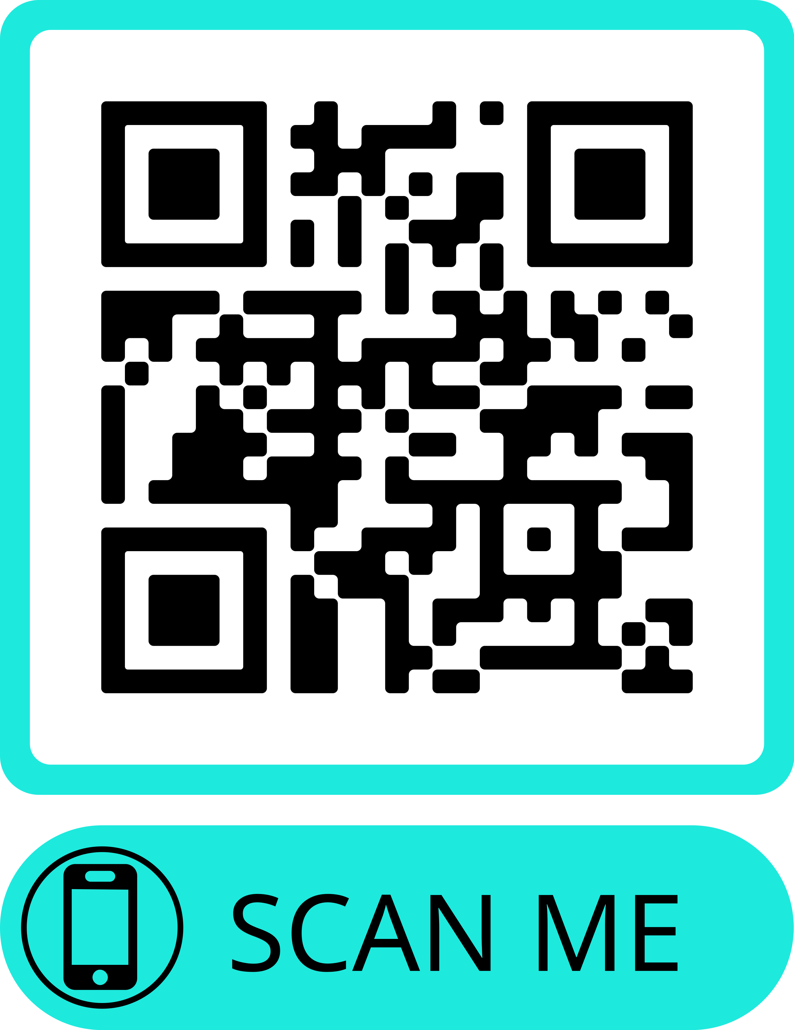

Slide 17
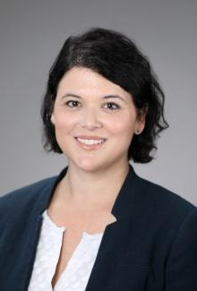
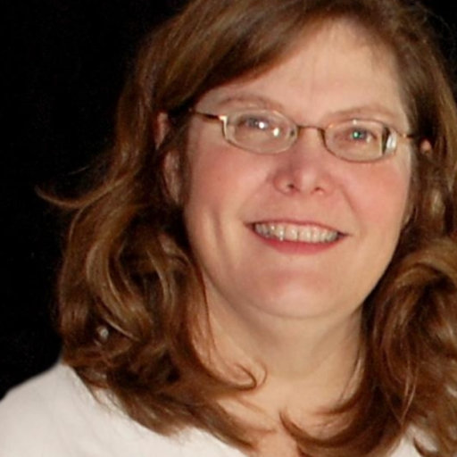
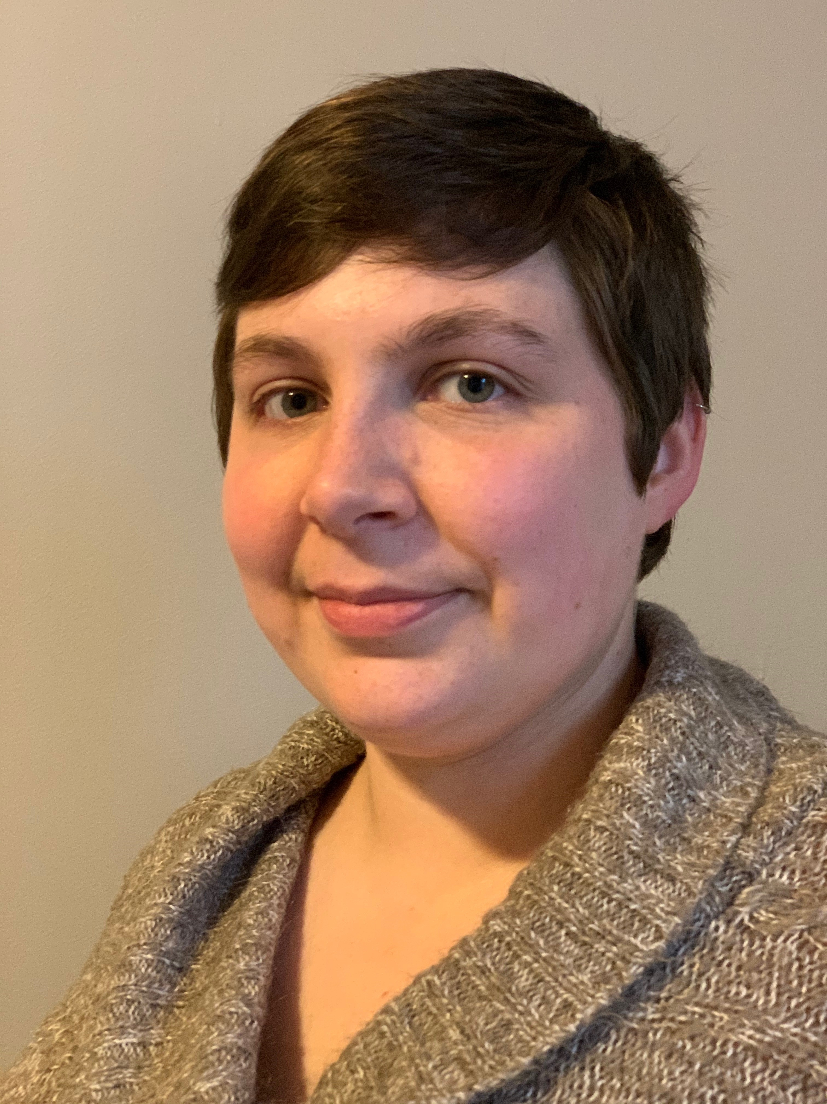
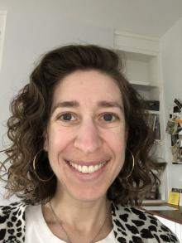


OUR TEAM
Emily Caporello
Taryn Aubrecht
Annette Gilchrist
Director
NINDS Small Business Program
emily.caporello@nih.gov
Scientific Project Manager
annette.gilchrist@nih.gov
Health Program Specialist taryn.aubrecht@nih.gov
Sara Dauber
Natasha Davis
Jessica Forbes
Small Business Strategic Consultant
sara.dauber@nih.gov
Operations Coordinator natasha.davis@nih.gov
AAAS S&TP Fellow
jessica.forbes@nih.gov

Slide 18




Connect with NINDS
Visit NINDS Small Business Program
Follow NIA on LinkedIn: NINDS Small Business Program
View Types of NINDS Small Business Grants and NINDS Small Business Program Areas of Interest
Email NINDS_SBIR@ninds.nih.gov

Slide 19
National Institute of Nursing Research
Kristopher Bough, PhD
Team Lead, Special Programs
Division of Extramural Science Programs

Slide 20
National Institute of Nursing Research
Our Mission:
Leading nursing science to solve pressing health challenges and inform practice and policy – optimizing health and advancing health equity into the future​
Notes:
The mission of the National Institute of Nursing Research (NINR)
is to lead nursing science to solve pressing health challenges and inform practice and policy –
optimizing health and advancing HE into the future
In 2022, NINR released a new strategic plan for research for 2022-2026.
The next few slides discuss our mission, guiding principles, research lenses and research framework.

Slide 21
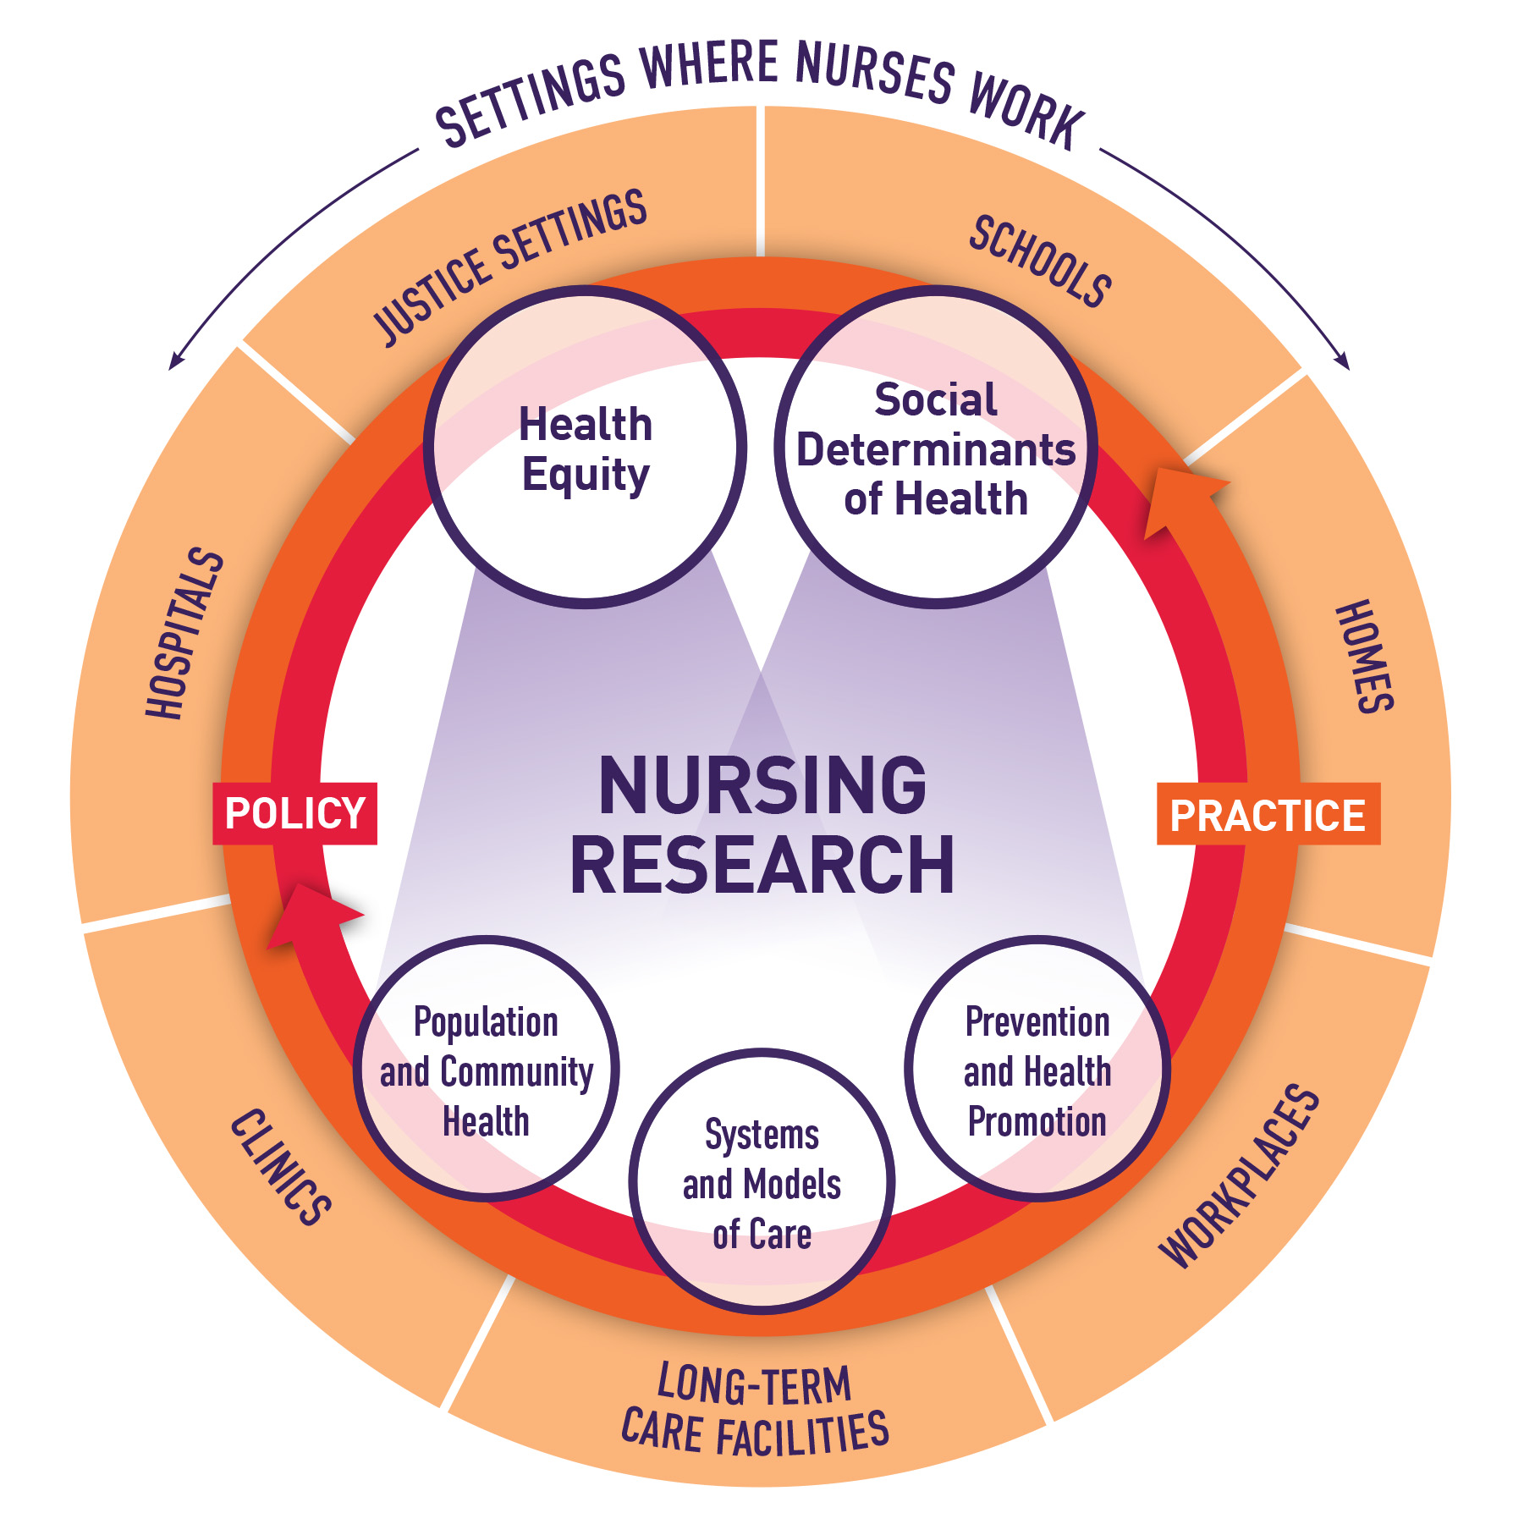
NINR's Research Framework
Notes:
These research lenses are complementary and synergistic.
Leveraging the strengths of nursing research, the lenses promote:
multilevel approaches,
cross-disciplinary and cross-sectoral collaboration, and
community engagement in research.
As shown in this research framework, NINR-supported investigators have the flexibility
to apply a single lens or a combination of lenses in their study designs and training programs.
We encourage researchers to view the health equity and social determinants of health lenses
as primary foci through which to consider the other lenses.

Slide 22





Research Priorities
Health Equity
Social Determinants of Health
Population and Community Health
Prevention and
Health Promotion
Systems and
Models of Care
Notes:
The new strategic plan also includes five research lenses. Let me explain what we mean by that term.
Simply put, when we say lens, we are describing a perspective through which to examine a health challenge.
In developing our scientific strategy, NINR identified five lenses that we think best leverage the strengths of
nursing science to innovate, think bigger, and greatly increase our impact.
The lenses in the strategic plan are:
HEALTH EQUITY - Research through our health equity lens aims to reduce and ultimately eliminate
the systemic and structural inequities that place some population groups at an unfair, unjust, and
avoidable disadvantage in attaining their full health potential.
SDOH - Research through our social determinants of health lens aims to identify
effective approaches to improve health and quality of life by addressing the conditions in which
people are born, live, learn, work, play, and age.
POPULATION AND COMMUNITY HEALTH - Our population and community health lens aims to address
critical health challenges at a macro level that persistently affect groups of people with shared characteristics.
PREVENTION & HEALTH PROMOTION - The next lens aims to prevent disease and promote health
through the continuum of prevention. From NINR’s perspective, prevention refers to actions taken
to reduce risk of disease, disability, or injury along a continuum from primordial (targeting underlying risks)
to tertiary prevention (reducing progression, severity, symptoms).
SYSTEMS AND MODELS OF CARE - We are interested in supporting nursing research that informs
the development, dissemination, and implementation of systems and models of care and
grapples with challenges, such as:
coordinating care and integrating data across clinical and community settings,
testing models of contextualized care, and
understanding the impacts of organizational practices and policy
on quality of care and its outcomes.

Slide 23
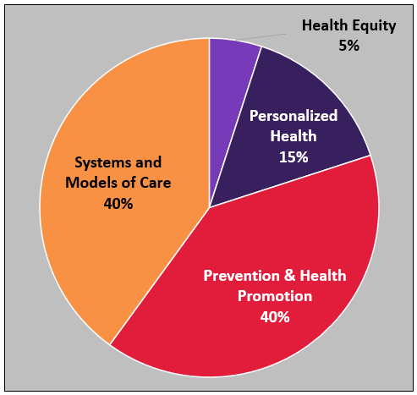
Scientific Areas of Interest
Personalized Health
Prevention & Health Promotion
Systems and Models of Care
Notes:
From these lenses, NINR’s small business program largely centers around
Innovative Systems and Models of Care and
Prevention and Health Promotion
As we move into our new strategic plan, an increasing number of
projects are focused on the development and implementation
of personalized health solutions and technologies that promote
health equity

Slide 24
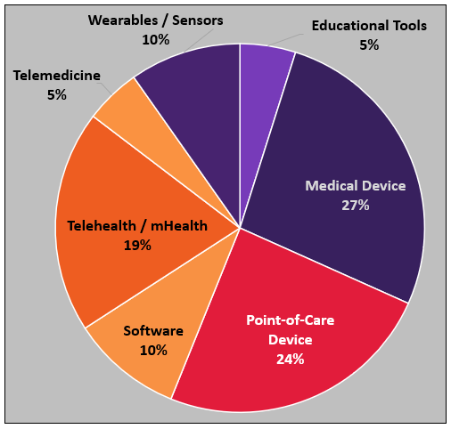
Technologies of Interest
Telehealth / mHealth
Point-of-Care Devices
Biomedical Sensors
Notes:
Here you can see the types of technologies that comprise
NINR’s SBIR/STTR portfolio. NINR prioritizes the
commercialization of digital health technologies and
point-of-care devices.
Digital Health technologies include mHealth,
telehealth / telemedicine, Internet-of-Things,
wearables and biomedical sensors, especially those
designed to innovatively enhance systems and models of care
such as coordinating care and integrating data across clinical
and community settings, testing models of contextualized
care – OR – digital health tools or POC devices for use in
primary, secondary or tertiary prevention.

Slide 25
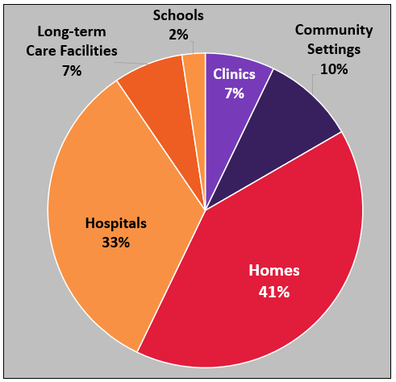
Use-case Settings
…not just hospitals
People’s Homes
Community Settings
Long-term Care Facilities
Notes:
NINR is currently supporting small businesses
to develop technologies beyond hospital settings.
As an example, this might include:
1. a mHealth technology that increases access to care
for persons living in rural community settings – OR –
2. A point-of-care device and mHealth platform
that passively and longitudinally monitors vital signs and
relays them to providers to coordinate care b/w formally-trained
providers and family members in their homes.

Slide 26
Funding Opportunities
Omnibus Solicitations (both General and Clinical Trials)
Phase I – Feasibility studies up to $296K ($325K waiver)
Phase II – R&D studies up to $1.97M ($2M waiver)
NINR does not participate in SBIR Phase IIB
Technical and Business Assistance (TABA) Supplement Funding (NOT-OD-21-062) – Phase I $6,500; Phase II $50K

Slide 27
Approved NINR Waiver Topics for awards over the SBIR/STTR Budget Limits
Digital health technologies to reduce health disparities
Digital health technologies that incorporate social determinants of health to advance innovative systems and models of care across care settings
Notes:
Here is a list of approved waiver topics for NINR for applicants who wish to apply for awards over the SBIR/STTR hard-caps.

Slide 28
Promoting Diversity
Applicant Assistance Program (AAP)
  Support for small businesses in search of their first Phase I SBIR/STTR proposal
Administrative Supplements to Promote Diversity in R&D at small businesses (PA-21-345)
Notes:
Small business who have not previously received NIH SBIR or STTR funding and are looking to submit a Phase I proposal to NINR are welcome to submit to the Applicant Assistance Program or AAP. The NIH is particularly interested in applications from socially or economically disadvantaged small businesses (SDB), women-owned small business (WOSB), and small businesses located in under-represented states. One of the main goals of the AAP is to increase participation in the SBIR and STTR programs by businesses that are owned or controlled by individuals who are traditionally underrepresented in biomedical sciences.
NINR also participates in the Administrative Supplements to Promote Diversity in SBC-based R&D. NINR makes SBIR and STTR funds available for admin supplements to enhance the diversity of the research and entrepreneurial WF by recruiting and supporting students, postdocs, and eligible investigators from diverse backgrounds, including those groups that have been shown to be underrepresented in health-related research or in the SBIR and STTR programs.

Slide 29
THANK YOU
MAKE AN APPOINTMENT WITH US!
Kristopher Bough, PhD
kristopher.bough@nih.gov
301.337.1372

Slide 30
The NCCIH
SBIR and STTR Program
Emrin Horgusluoglu, Ph.D.
June 21, 2023

Slide 31

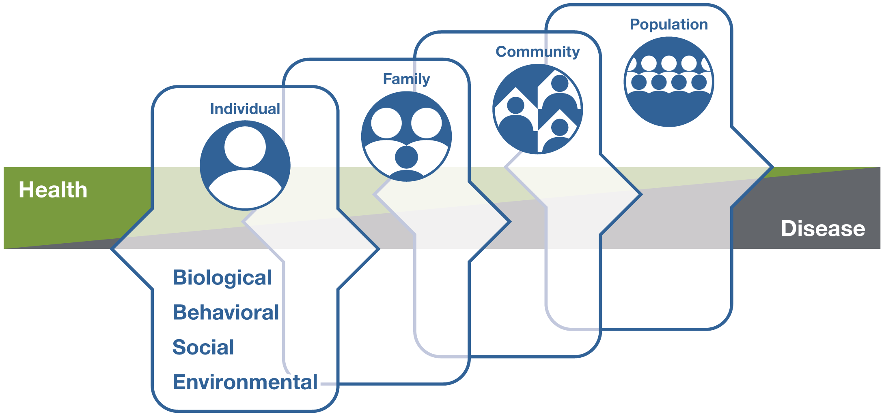
NCCIH Strategic Plan FY 2021–2025
Mapping a Pathway to Research on Whole Person Health
Social
Neural/psychological
Respiratory
Cardiovascular
Digestive
Health
Reproductive
Disease
Endocrine
Metabolic
Musculoskeletal
Immune
Microbial

Slide 32
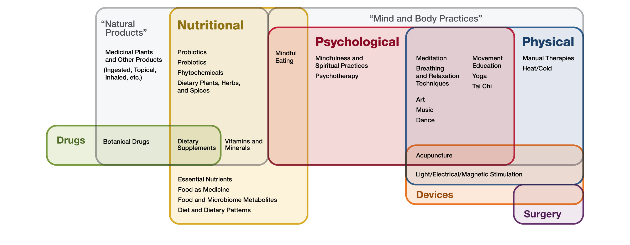
NCCIH-supported Interventions
Notes:
This graphic shows the primary therapeutic input of approaches that may be studied within the NCCIH portfolio. The specific modalities are meant to be illustrative of the types of approaches that fall within these categories.

Slide 33

Scope of NCCIH SBIR/STTR Programs​
NCCIH SBIR and STTR Waiver Topics
Development and validation of biomarkers
Innovative technologies and methods to assess natural product–drug interactions in humans
Integrated in silico tools for exploiting natural product bioactivity
AI/ML-based sensory/diagnostic devices or applications
Tools and technology for music-based interventions
Development and validation of mobile/digital technologies
Phase I
Phase II
CRP
Feasibility and
Proof of Concept.
Research/Research
and Development.
Fast Track
Direct to Phase II
Phase I: $295,924 for a project timeline between 6 months to 2 years.
Phase II: $1,972,828 for a project timeline between 1 to 3 years.

Slide 34
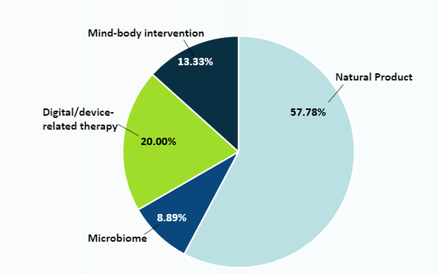
The NCCIH Small Business Program
Areas Funded by NCCIH SBIR/STTR Program
Innovative and commercially promising products that can facilitate the integration of complementary and integrative health approaches to enhance diagnosis, prevention, or treatment of diseases and/or associated symptoms, or promotion of well-being and whole person health

Slide 35
Small Business Funding Opportunities
NOT-AT-20-015 Methods Development in Natural Products Research (SBIR/STTR)
NOT-EB-23-002 Synthetic Biology for Biomedical Applications.
NOT-AT-21-001 Development and/or Validation of Devices or Electronic Systems to Monitor or Enhance Mind and Body Interventions (SBIR/STTR)
NOT-OD-21-100 Improving Patient Adherence to Treatment and Prevention Regimens to Promote Health

Slide 36
Small Business Funding Opportunities
RFA-NS-23-006 HEAL INITIATIVE SBIR Preclinical Pain Management
RFA-NS-23-007 HEAL INITIATIVE STTR Preclinical Pain Management
NOT-MH-21-125 Translation of BRAIN Initiative Technologies to the Marketplace

Slide 37

https://nccih.nih.gov/grants
Subscribe to NCCIH Update
Notes:
To find out more information about our SBIR/STTR activities, please visit the grants tab on our website, connect and contact us, and subscribe to our email listserv – NCCIH update.
Thank you very much for your attention. I now welcome your questions and comments.

Slide 38
NIDDK Small Business Programs
Launching Biomedical Innovators
June 21, 2023
Danny Gossett, Ph.D.
Program Director
Division of Kidney, Urologic, & Hematologic Diseases
National Institute of Diabetes and Digestive and Kidney Diseases
daniel.gossett@nih.gov

Slide 39
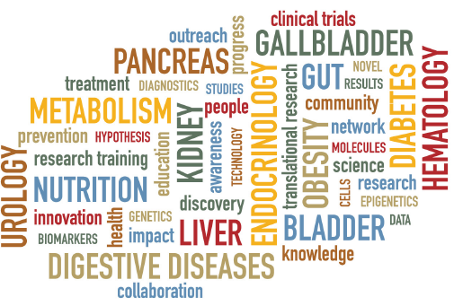
Research Mission of the NIDDK
Chronic
Common
Consequential
Costly
The Small Business Programs help NIH accelerate
discoveries from bench to bedside
https://www.niddk.nih.gov/research-funding/research-programs

Slide 40
NIDDK SBIR/STTR R&D Areas
Drugs (drugs, vectors, cell therapies, etc.)
Devices (therapeutic devices, surgical tools, etc.)
Diagnostics (assays, imaging, omics, or precision medicine)
Software (e.g., decision support, education)
Research Tools (e.g., disease models, tissue chips)
FY 2022 SBIR/STTR Competing Awards (NIH RePORTER, https://reporter.nih.gov/)

Slide 41
Open Funding Opportunities
General Grant Omnibus Solicitations (Parent Funding Opportunities)
  Clinical Trial Not Allowed:
  SBIR and STTR
  Clinical Trials Required:
  SBIR
“Program Descriptions and Research Topics” Section in the Funding Opportunities
Targeted Solicitations
Specific Grant Solicitations: https://seed.nih.gov/small-business-funding/
Innovations for Healthy Living - Improving Minority Health and Eliminating Health Disparities (R43/R44 - Clinical Trial Optional)
RFA-MD-23-003
Application Due Date: September 06, 2023
See NOT-OD-23-124 for Anticipated Publication of the PHS 2023-2 Omnibus Solicitations

Slide 42



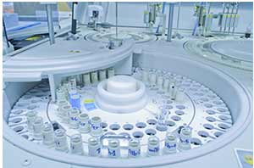
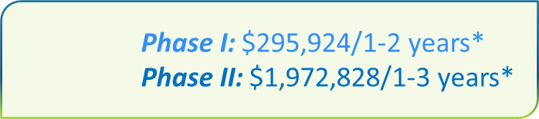

Phased Programs
Feasibility
Phase I
Full R&D
Phase II
Commercial Market
Partner or Investor
Competing Renewal Award
Phase IIB
Commercialization Readiness Pilot (CRP)
Phase I Phase II
Fast-Track
Only Some NIH Institutes/Centers Participate
*NIH and CDC have a waiver from the Small Business Administration to exceed these budgets for selected topics
Direct to Phase II
(SBIR only)
The NIDDK generally considers:
Phase I budgets up to $325,000 total
Phase II applications up to $2,000,000 total costs generally <$1M TC/year)
Phase IIB applications up to $3,000,000 total costs generally <$1M TC/year)
CRP applications up to $1,000,000 total costs

Slide 43
NIH SBIR/STTR Diversity Supplement
PA-21-345
Administrative Supplement to Promote Diversity in Research and Development Small Businesses (NIH and CDC)
Purpose: Enhance the diversity of the research and entrepreneurial workforce
Small Businesses with active small business awards (SBIR/STTR)
Recruit and support individuals from diverse backgrounds
Career Level
Undergraduate
Graduate
Degree Holders
Postdoctoral
Developing Independent Career
https://seed.nih.gov/diversity_supp

Slide 44
Scientific Mission Areas
Division of Diabetes, Endocrinology,
and Metabolic Diseases
Mission Areas:
  Diabetes prevention, diagnosis and management. Novel technologies and treatment.
  Acute and Chronic complications of diabetes
  Other endocrine disorders including hypophysis, thyroid, adrenal, neuroendocrinology and bone metabolism.
  Obesity and energy balance
  Cystic Fibrosis and its metabolic impact
Example Technologies:
  Continuous glucose monitoring and insulin delivery technologies, integration into an automated artificial pancreas system (APS).
  Smart insulin, glucagon and novel drugs for glycemic control
  Multiplex antigen panel for early detection and monitoring of Type 1 Diabetes
  Technologies to support cell replacement therapies for diabetes
  Wound healing and diabetic foot ulcer (DFU) treatments
Guillermo A. Arreaza-Rubin, M.D.
Diabetic Technology, Type 1 Diabetes, and Endocrine Diseases
guillermo.arreaza-rubin@nih.gov
Yan Li, Ph.D.
Diabetic Wound Healing and Type 2 Diabetes
liy7@mail.nih.gov
Bradley M. Cooke, Ph.D.
Neuromodulation, Diabetic Neuropathy and Type 2 Diabetes Drug Discovery
brad.cooke@nih.gov
https://seed.nih.gov/NIDDK/scientific_program_areas

Slide 45
Division of Digestive Diseases & Nutrition
Division of Digestive Diseases and Nutrition
Mission Areas:
  Digestive diseases, including the alimentary tract, liver, and pancreas
  Nutrition and nutrient metabolism
  Obesity, including type 2 diabetes, energy balance, neurobiology
Example Technologies:
  Technologies for visualization and automated analysis of gastrointestinal motility
  Clinical assay for genetic causes of liver disease in children
  Immunoassay for studying iron regulation and assessing it clinically
  Wearable technologies (e.g., in earbuds or shoe-soles) for monitoring caloric expenditure
  Animal models of metabolic syndrome and obesity that more accurately recapitulate aspects of these diseases in humans
Christine Densmore, M.S.
Liver, Pancreatic, and Neurobiological Disorders and Diseases
christine.densmore@nih.gov
R. Dwayne Lunsford, Ph.D.
Gastrointestinal, Obesity, and Nutrition Disorders and Diseases
robert.lunsford@nih.gov
https://seed.nih.gov/NIDDK/scientific_program_areas

Slide 46
Division of Kidney, Urologic, & Hematologic Diseases
Division of Kidney, Urologic, and Hematologic Diseases
Mission Areas:
  Kidney diseases
  Urinary tract diseases
  Disorders of the blood and blood-forming organs
Example Technologies:
  Animal or 3D culture models of kidney diseases such as polycystic kidney disease
  Improved measurements of kidney function
  Hemodialysis vascular access technologies such as novel grafts or approaches to enhance fistula maturation
  Materials for urinary and dialysis catheters which resist fouling
  Assays for key iron-regulating hormones, to diagnose blood diseases
Danny Gossett, Ph.D.
daniel.gossett@nih.gov
https://seed.nih.gov/NIDDK/scientific_program_areas

Slide 47
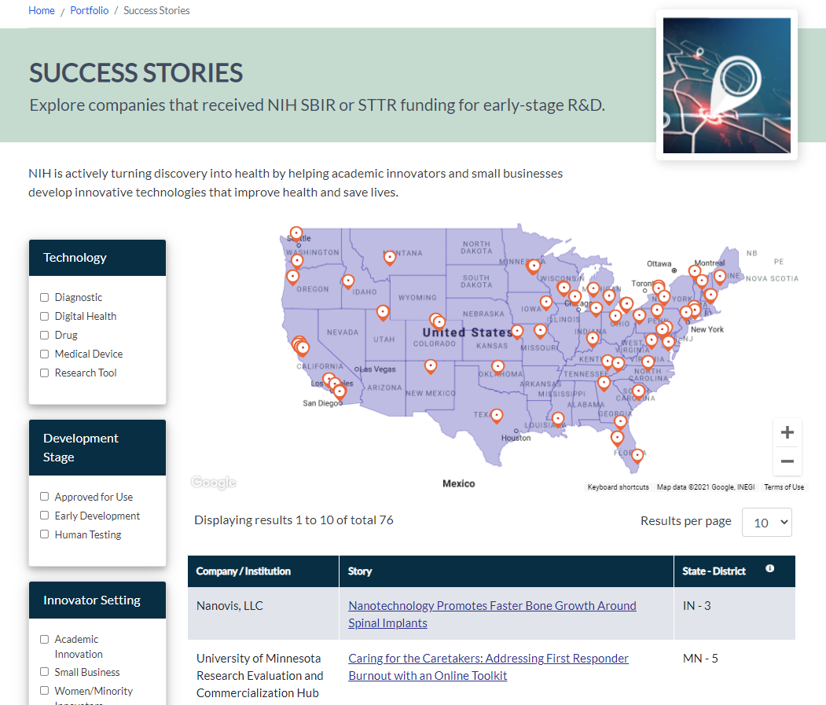


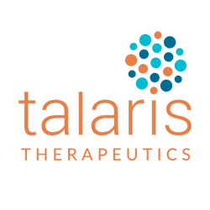
Small Business Success Stories
Making Cells Feel at Home in the Lab Leads to Better Drugs for Rare Diseases
Lab-Grown Blood Vessels Could Help Dialysis Patients
Talaris Uses “Nurse Cells” to Get Transplant Patients Off Immunosuppressants
https://seed.nih.gov/portfolio/stories

Slide 48
More Information About NIDDK Programs
Program Descriptions and Research Topics: https://seed.nih.gov/sites/default/files/HHS_Program_Descriptions.pdf
Strategic Plans & Reports: https://www.niddk.nih.gov/about-niddk/strategic-plans-reports
Pathways to Health for All: Health Disparities & Health Equity Research Recommendations & Opportunities: https://www.niddk.nih.gov/about-niddk/strategic-plans-reports/pathways-health-all
Contact Us!
Danny Gossett
daniel.gossett@nih.gov

Slide 50
Introduction to the NIAMS SBIR and STTR Program
Xibin Wang, Ph.D
Small Business Program Director
NIAMS

Slide 51
National Institute of Arthritis and Musculoskeletal and Skin Diseases (NIAMS)
Rheumatic Diseases
  rheumatoid arthritis, juvenile idiopathic arthritis, Lyme arthritis, gout, lupus, systemic scleroderma
Musculoskeletal Diseases
  osteoporosis, osteoarthritis, muscular dystrophy, tissue engineered products, orthopedic devices
Skin Diseases
  psoriasis, acne vulgaris, atopic dermatitis, wound healing

Slide 52
Major Overlaps with Other Institutes or Centers
Rheumatic Diseases
  NIAID: Immunology
Musculoskeletal Diseases
  NIA: Osteoporosis, Osteoarthritis, Injury in elderly
Skin Diseases
  NIDDK: Diabetic wounds
  NIGMS: Burn wounds
  NIAID: Infection and Immunology in inflammation
  NCI: Skin cancer

Slide 53
SBIR/STTR Budget
SBIR set-aside
STTR set-aside
3.2% of Extramural Budget for R&D
NIAMS SBIR
FY2022: $17.38M
0.45% of Extramural Budget for R&D
NIAMS STTR
FY2022: $2.44M

Slide 54
SBIR/STTR: 3-Phase Program
Phase I
    Feasibility Study, 6 to 12-month Award
    Guideline $150 K, Hard Cap $295K*
  Phase II
    Full Research/R&D, 2-year Award
    Guideline $1 M, Hard Cap $1.97 M*
  Post-phase II
    Commercialization Readiness Program (CRP)
    Phase IIb (NIAMS not participating)
  Technical and Business Assistance (TABA)
    Phase I: $6,500 and Phase II: $50,000

Slide 55
NIAMS Small Business Funding Opportunities
NIH Parent SBIR PA (Clinical Trial Not Allowed)
  Reissue in July
NIH Parent STTR PA (Clinical Trial Not Allowed)
  Reissue in July
NIAMS does not support clinical trials with the small business program.

Slide 56
NIAMS Small Business Funding Opportunities
PAR-23-032 Late-Stage Translation of Biomedical and Behavioral Research Results in Arthritis and Musculoskeletal and Skin Diseases from Academic/Non-profit Lab to Marketplace (SBIR)
Phase I $300K, Phase II $2M
RFA-NS-23-006 HEAL INITIATIVE SBIR Preclinical Pain Management
RFA-NS-23-007 HEAL INITIATIVE STTR Preclinical Pain Management
PA-21-345 Administrative Supplements to Promote Diversity SBIR/STTR (Phase II for NIAMS)
NOT-EB-21-001 Small Business Initiatives for Innovative Diagnostic Technology for Improving Outcomes for Maternal Health

Slide 57
Product Categories
Diagnostic Tools
Therapeutic devices
Tissue engineering products
Biologics (antibodies, RNA, DNA)
Small molecules

Slide 58
Contact:
Xibin Wang, Ph.D
Email: wangx1@mail.nih.gov
Phone: 301-451-3884
Cell phone: 301-792-5718

Slide 59



NIA Small Business SEED Fund:
Accelerating Alzheimer’s
and Aging Research
JLABS December 2022

Slide 60
NIH SBIR/STTR Budget Allocation FY23
FY23 NIH SBIR/STTR
Budget ~ $1.3 billion
FY23 NIA SBIR/STTR
Budget ~ $150 million*
Represents significant growth from the FY15 NIA SBIR/STTR budget of ~$34 million
*estimate

Slide 61
We Strategically Fund Innovations for:
Alzheimer’s disease (AD), AD-related dementias (ADRD), and age-related change in brain function
Aging in place
Age-related diseases
and conditions
Research tools
Additional Areas of Interest
Companion diagnostics and other forms of personalized medicine
Bioinformatics, public health informatics, or data science technologies/methods (e.g., machine learning, artificial intelligence) to better understand and predict health outcomes
Novel cell and gene therapies, as well as other novel therapeutic approaches to AD/ADRD
Biomarkers and diagnostic tools for the early detection of disease
Prevention and therapeutics that directly target mechanisms related to aging biology
Assistive technology, devices, and mobile applications for older adults and caregivers
Tools, technologies, and analytic methods to address health disparities among older adults
Notes:
New pie chart

Slide 62
SBIR & STTR Program Phases and Funding Levels
Phase I | Discovery & Feasibility | Typically 1 year in length Awards up to $300,000, or up to $500,000 for AD/ADRD Establish technical merit, feasibility, and potential for commercialization
Phase II | Development & Full R&D | Typically 2 years in length Awards up to $2 million, or up to $2.5 million for AD/ADRD Continues Phase I R&D efforts Requires a commercialization plan
Phase IIB | Competing Renewal | Up to 3 years Awards up to $3 million
Fast Track
One combined application for Phases I and II
Apply directly for Phase II funding
Demonstrated feasibility through other funding sources
Direct-to-Phase II (SBIR only)
Funding for late-stage R&D and technical assistance for commercialization
Awards up to $3.4 million
Commercialization Readiness Pilot
Notes:
Will be updated w budgets

Slide 63
NIA Resources to Help Research Entrepreneurs
Pre-SBIR
NIA Startup Challenge and Accelerator: Fostering Entrepreneurial Diversity. Provide training, mentoring, networking, and the opportunity for a cash prize for early-stage innovators from historically excluded backgrounds and founders working on health disparities in the older adult population
Research and Entrepreneurial Development Immersion (REDI): Multiple awards to prepare and expose early-career researchers to life science entrepreneurship
Applicants
Sample Applications. Review other successful applications on our website to see what information other applicants included and how they presented it. | Applicant Assistance Program. A 10-week coaching program to help prepare your Phase I application. Open to first-time and never-funded applicants.
Phase I Awardees
Innovator Support. Support from the NIA Entrepreneurs-in-Residence including business consults, pitch coaching, company showcase opportunities and various supplemental awards (s.a. TABA funds and diversity supplement).
Additional Resources and Support for Grantees. Companies that receive SBIR/STTR awards are eligible to apply for additional funding, technical assistance, and training programs such as the I-Corps™ at NIH program, C3i Medical Device Entrepreneurial Training Program, and training programs designed for diverse applicants.

Slide 64
NIA Resources to Help Research Entrepreneurs
Pre-SBIR
NIA Startup Challenge and Accelerator: Fostering Entrepreneurial Diversity. Provide training, mentoring, networking, and the opportunity for a cash prize for early-stage innovators from historically excluded backgrounds and founders working on health disparities in the older adult population
Research and Entrepreneurial Development Immersion (REDI): Multiple awards to prepare and expose early-career researchers to life science entrepreneurship
Applicants
Sample Applications. Review other successful applications on our website to see what information other applicants included and how they presented it. | Applicant Assistance Program. A 10-week coaching program to help prepare your Phase I application. Open to first-time and never-funded applicants.
Phase I Awardees
Innovator Support. Support from the NIA Entrepreneurs-in-Residence including business consults, pitch coaching, company showcase opportunities and various supplemental awards (s.a. TABA funds and diversity supplement).
Additional Resources and Support for Grantees. Companies that receive SBIR/STTR awards are eligible to apply for additional funding, technical assistance, and training programs such as the I-Corps™ at NIH program, C3i Medical Device Entrepreneurial Training Program, and training programs designed for diverse applicants.

Slide 65

2022-23
NIA Start-Up Challenge & Accelerator
Fostering Entrepreneurial Diversity
Co-sponsored with the Office of Special Populations

Slide 66
NIA Start-Up Challenge and Accelerator
The goal of this Challenge is to…
  Foster diversity in aging research, innovation, and entrepreneurship, and
  Meet the congressional goal to encourage SBIR and STTR participation by socioeconomically disadvantaged small businesses and women-owned small businesses.
A prize competition to provide strategic resources to entrepreneurs with…
  An innovative idea for a research-driven technology or product that will increase diversity in aging research and innovation, and
  A demonstrated need for the Challenge to help accelerate their idea (pre-SBIR stage)
Challenge resources can help diverse entrepreneurs launch or grow a start-up and execute activities that can improve a future NIA SBIR or STTR R&D proposal.

Slide 67
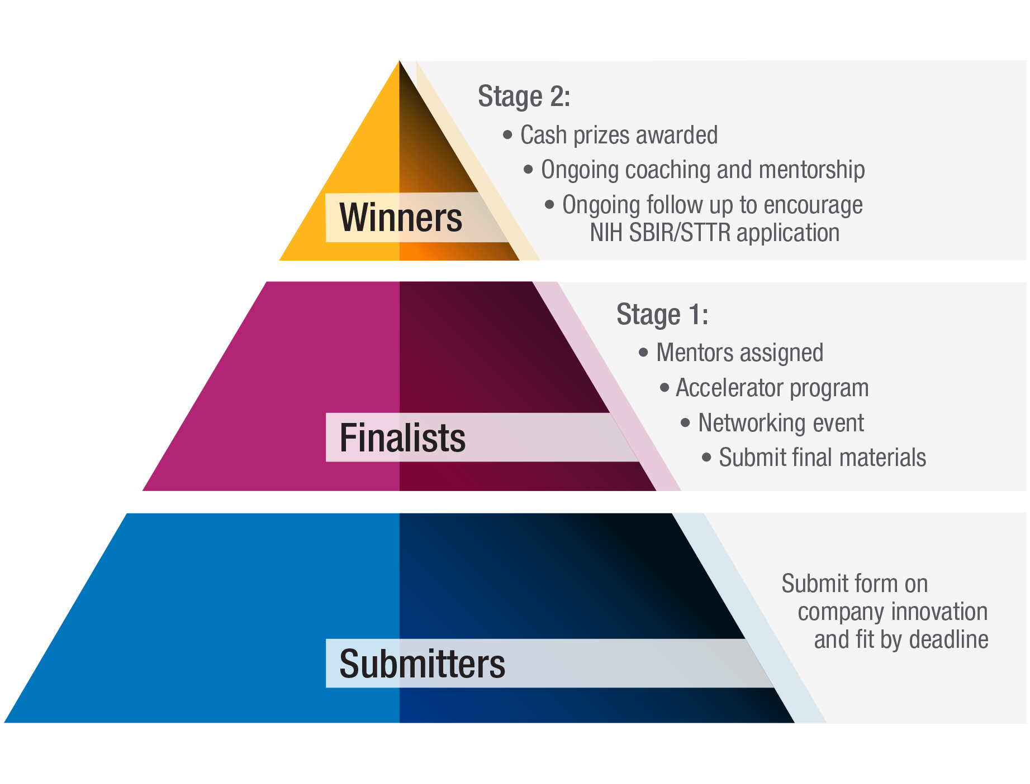
Challenge Overview

Slide 68
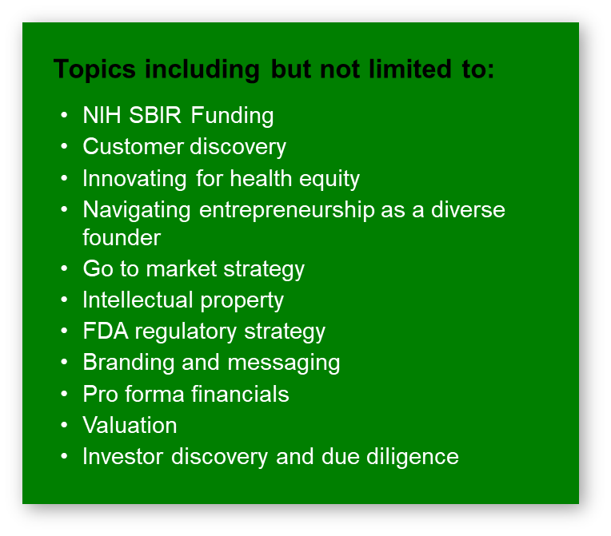
Challenge Overview
In-depth entrepreneurial training

Slide 69
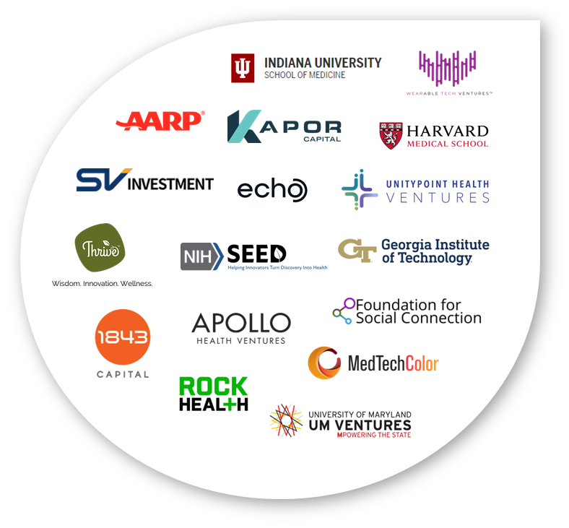
Challenge Overview
1-on-1 Mentoring and
Access to experienced networks
In-depth entrepreneurial training

Slide 70


Broad Participant Success
5 companies have won national pitch competitions
since participating in the Challenge
Company | Achievement
AROMA | Alz Association and MATTER Pitch Competition Finalist and Audience Choice Winner
Digicare Realized | Launched Company and Hired C-Suite Member(s)
FraudFindr | AARP FinTech Pitch Competition Winner
FraudFindr | AARP AgeTech Collaborative Winter 2023 Cohort
FraudFindr | Company Acquired
Hydro Gummy | National ACE Minority Women Lead Winner
Hydro Gummy | ATHENA Female Founders Pitch Competition Finalist
Hyrdo Gummy | AARP AgeTech Collaborative Winter 2023 Cohort
Moremme VA | Halcyon 2023 The Future Builders Intensive Incubator
NeuroAge Therapeutics | MBC BioLabs Diversity Golden Ticket
NeuroAge Therapeutics | Awarded Illumina Sequencing Grant
NeuroAge Therapeutics | Stanford Applied Longevity Translation Symposium Pitch Competition Winner
Suma | RESI Boston Pitch Competition Winner

Slide 71

Research & Entrepreneurial Development Immersion (REDI)
Notes:
Formerly called ENRICH program which was presented at the summer retreat by Shahrooz and Todd.
The idea is a series of funding opportunities amined at Entrepreneurship training in NIA-mission areas and allowing trainees to acquire additional non-academic skillset.
This chart illustrates the nature of the program: We are interested in utilizing the K01 and R25 mechanisms to support training at graduate student and postdoctoral levels. And a SBIR grant that encourages what we like to call “first-time” entrepreneur-scientists.

Slide 72
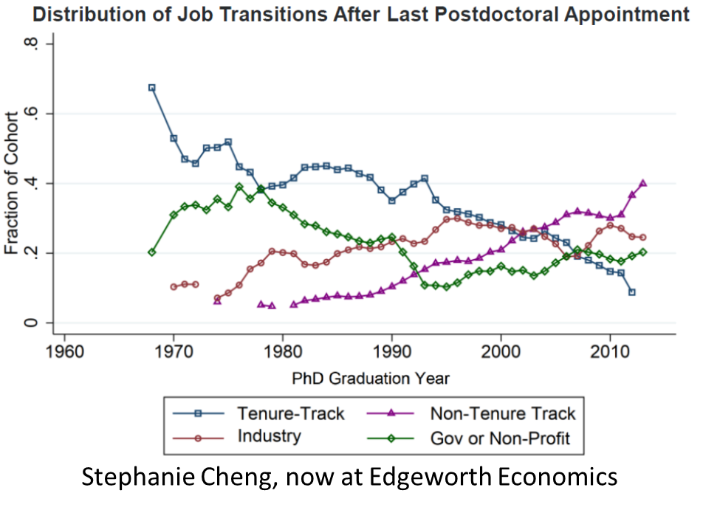
Research & Entrepreneurial Development Immersion (REDI)
Postdocs transitioning to tenure track positions
Notes:
Formerly called ENRICH program which was presented at the summer retreat by Shahrooz and Todd.
The idea is a series of funding opportunities amined at Entrepreneurship training in NIA-mission areas and allowing trainees to acquire additional non-academic skillset.
This chart illustrates the nature of the program: We are interested in utilizing the K01 and R25 mechanisms to support training at graduate student and postdoctoral levels. And a SBIR grant that encourages what we like to call “first-time” entrepreneur-scientists.

Slide 73
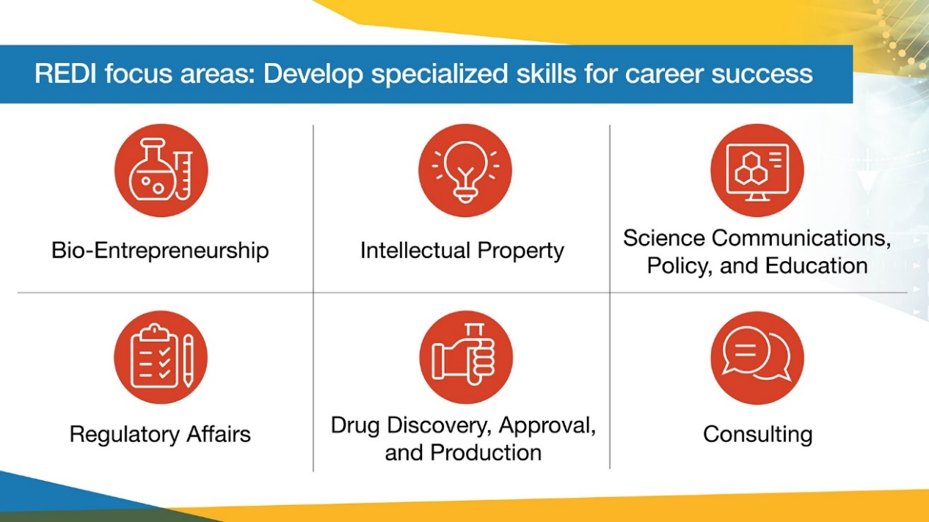
Research & Entrepreneurial Development Immersion (REDI)
A series of Funding Opportunities aimed at:
  Entrepreneurship training in NIA-mission areas
  Allowing trainees to acquire additional non-academic skills
Notes:
Formerly called ENRICH program which was presented at the summer retreat by Shahrooz and Todd.
The idea is a series of funding opportunities amined at Entrepreneurship training in NIA-mission areas and allowing trainees to acquire additional non-academic skillset.
This chart illustrates the nature of the program: We are interested in utilizing the K01 and R25 mechanisms to support training at graduate student and postdoctoral levels. And a SBIR grant that encourages what we like to call “first-time” entrepreneur-scientists.

Slide 74
The REDI umbrella
FOA | Audience/Due Dates | Budget Limits
PAR-22-227 (REDI: Mentored Entrepreneurial Career Development Award; K01 clinical trial not allowed) | Early-stage researchers (Postdocs and Junior Faculty) Application: October 18, 2023 | $90,000/year in salary; $50,000/year in other program-related expenses
PAR-22-226 (REDI: Entrepreneurship Enhancement Award; R25 clinical trial not allowed) | Trainees (graduate students and postdocs) Application: October 18, 2023 | $250,000/year in direct costs
RFA-AG-23-029 / RFA-AG-22-030 (REDI: Entrepreneurial Small Business Transition Award; SBIR/STTR clinical trial optional) | Early-stage researchers (Postdocs and Junior Faculty) Application: TBD | Phase I $400,000; Fast-Track $2 million

Slide 75
REDI K01 Overview
PURPOSE
Provide protected time over 3-5 years for a supervised career development experience leading to research independence. Entrepreneurship training, in a field relevant to NIA mission, is a major focus.
REQUISITES
Two Mentors: a Research Mentor & an Entrepreneurial Mentor. Internships, shadowing opportunity and externships are encouraged. Applicants encouraged to spend time with a startup, local biotech company, foundation, life science investment firm or relevant organization. SBIR/STTR grant writing can be considered as part of training.
ELIGIBILITY
Postdoctoral scholars (at least 2 years minimum) and/or recently appointed junior faculty. Can not have received a prior R01, P01, P50, or other major career grants. Individuals with (a) underrepresented racial and ethnic backgrounds and (b) disabilities are strongly encouraged.

Slide 76
REDI R25 Overview
PURPOSE
Promote the development of entrepreneurial education programs to broaden the skillset of graduate students & postdocs in the fields relevant to the mission of NIA.
REQUISITES
Courses and workshops with a broad scope: product development, commercialization, scientific communication, tech transfer, science policy, drug development, regulatory affairs, finance, marketing, business dev & research administration. Shadowing or interning experiences are encouraged. Diversity Recruitment Plan is required.
ELIGIBILITY
Broad eligibility for educational institutions. We encourage partnering with existing NIH-funded or other federally funded resources and programs, such as NCAI, REACH, NSF-I-Corps, etc.

Slide 77
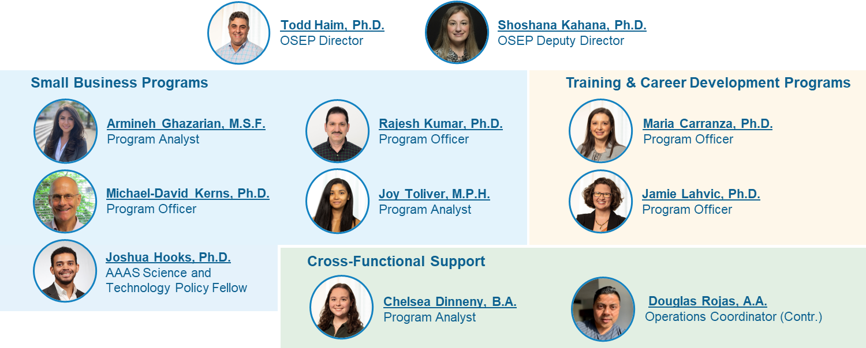
We are a resource for all applicants and awardees.
Please reach out to us
NIA Office of Strategic Extramural Programs (OSEP)

Slide 78

Any Questions?
We are a resource for the NIA staff.
Please reach out if you have any questions!

Slide 79
Advancing Genomic Research and Commercialization through the NHGRI Small Business Program
Katie Bardsley
Launching Biomedical Innovators – 6/21/23

Slide 80

Introduction to NHGRI
As a leading authority in the field of genomics, our mission is to accelerate scientific and medical breakthroughs that improve human health. We do this by driving cutting-edge research, developing new technologies, and studying the impact of genomics on society.
Read about NHGRI’s ambitious agenda for advancing the field of human genomics in our 2020 Strategic Vision!
genome.gov/2020sv

Slide 81






Research Areas Supported by NHGRI:
Genomic Technology & Methods Development
Bioinformatics, Computational Genomics, & Data Science
Population Genomics & Genomic Medicine
Ethical, Legal, & Social Implications of Genomics
Genomic Training & Education

Slide 82
Program Structure
Concept Development
Prototype Development
Phase I
6 months - 1 year
< $400k total costs*
Phase II
24 months
< $2M total costs*
Direct-to-Phase II
24 months
< $2M total costs**
Non-SBIR/STTR funds
Fast-Track
Phases I & II combined
*For applications that align with a range of specific topics in genomics
Notes:
Proof of principle – phase I
Pre-commercialization – phase II
Different ways to enter program depending on stage
Need to commercialization plan for Phase II, big difference
Simplify to highlight key differences

Slide 83

Active Funding Opportunities:
RFA-CA-23-035: Small Business Transition Grant For Early Career Scientists (due: 8/21/23)
Omnibus Announcements:
  NOT-OD-23-124: Notice of Anticipated Publication
Notices of Special Interest:
  NOT-HG-21-018: Advancing Genomic Technology Development for Research and Clinical Application
  NOT-HG-22-011: Development and Implementation of Clinical Informatics Tools to Enhance Patients’ Use of Genomic Information
  NOT-HG-21-038: Genomics Education Interactive Digital Media Resources
Notes:
Omnibus – anything in NHGRI mission:
As a leading authority in the field of genomics, our mission is to accelerate scientific and medical breakthroughs that improve human health. We do this by driving cutting-edge research, developing new technologies, and studying the impact of genomics on society.

Slide 84


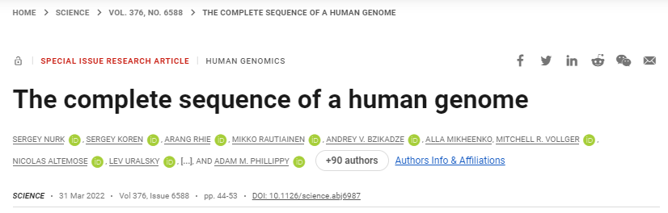




Examples of Recent Success:
Notes:
Over $17M in SB funding
Also vertebrate genome project
Amazing to see how the work of these small businesses is advancing the forefront of genomics
NIH-funded startups are fueling the era of genome-completeness

Slide 85
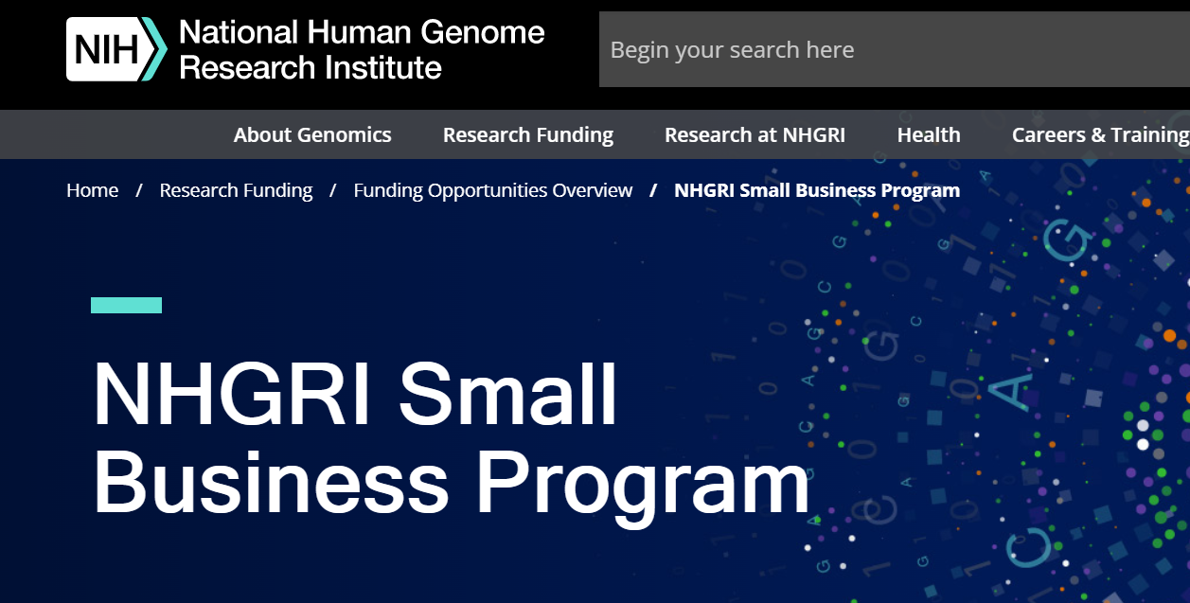
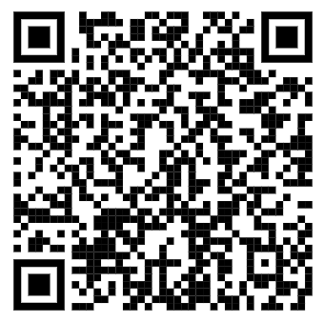

Where to find us!
NHGRI Small Business Webpage:
genome.gov/small-business
Contact us by email:
nhgri_smallbusiness@nih.gov

Slide 86
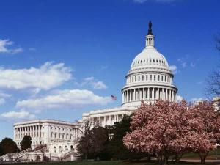
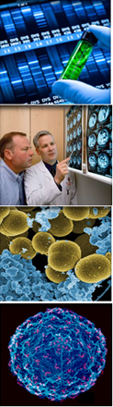

National Institute of Allergy and Infectious Diseases (NIAID), NIH
Launching Biomedical Innovators
NIAID SBIR/STTR Program
Overview
Hejiao English, Ph.D.
Health Specialist
SBIR/STTR Program, NIAID, NIH
June 21, 2023

Slide 87
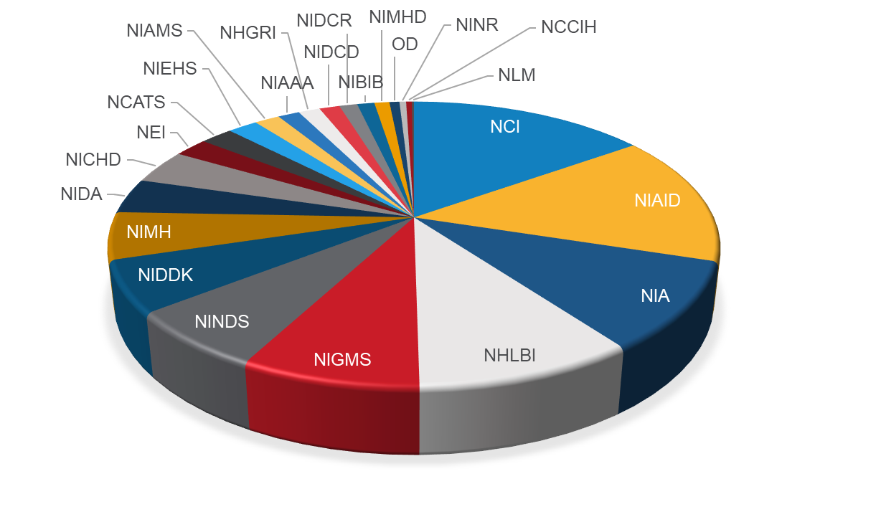
NIH SBIR/STTR Budget Allocation FY23
NIH SBIR/STTR Budget
$1.347 billion (B)
NIAID SBIR/STTR Budget $195.2 (M)

Slide 88
NIAID’s Mission Statement
NIAID conducts and supports basic and applied research to better understand, treat, and ultimately prevent infectious, immunologic, and allergic diseases.
NIAID has a unique mandate that requires the Institute to respond to emerging public health threats.
NIAID’s three extramural divisions are the Division of AIDS (DAIDS); Division of Allergy, Immunology, and Transplantation (DAIT); and Division of Microbiology and Infectious Diseases (DMID).

Slide 89
NIAID Specific SBIR/STTR Policies
Waiver Policy – Phase I: $300K/year for up to 2 years; Phase II: $1M/year for up to 3 years
  Topics are interpreted broadly by NIAID Program Officers.
  Does not impact funding decision (may be reduced if needed)
NIAID allows Phase IIB applications via the SBIR Parent and select funding opportunity announcements (FOAs).
  Matching funds encouraged (not required)
  SBIR only (Phase II STTR awardees can switch)
NIAID only accepts SBIR Clinical Trial applications through its U44 mechanism (PAR-21-082).
  Phase II/IIB, Fast-Track, and Direct-to-Phase II
NIAID participates in the Commercialization Readiness Pilot (CRP) Program via PAR-20-129 (currently expired, will be reissued in July 2023).
NIAID funds applications primarily based on Scientific Merit (i.e., Priority Score).
  All applications (except CRP, U44) within published paylines are funded. CRP and U44 funding decision is based on a combination of programmatic interest and review score.

Slide 90
NIAID Small Business Applicant Assistance Program (AAP) Program Overview
NIAID Small Business Applicant Assistance Program (AAP) provides assessment, coaching, proposal development assistance, and post-submission support for SBIR/STTR Phase I and Phase II/IIB (including Fast-Track & Direct-to-Phase II) applicants with the following goals:
  Improve the quality of NIAID SBIR/STTR applications
  Improve SBIR/STTR accessibility for underrepresented entrepreneurs and investigators
The program consists of both 1 on 1 customized applicant assistance with assigned consultants (25 consulting hours/ applicant over 12 weeks) and online webinars, toolkits, templates, and resources.
The NIAID AAP program has 3 cycles for the 3 upcoming SBIR/STTR application submission deadlines: September 5, 2023, January 5, 2024, and April 5, 2024.
First 35 eligible applicants for each cycle will be enrolled in the program.
Foresight Science & Technology was selected as supporting contractor for the NIAID AAP program.

Slide 91
NIAID Applicant Assistance Program (AAP) Eligibility Criteria
The research area of interest aligns with the mission of NIAID. Read NIAID High-Priority Areas of Interest to help you determine if your application aligns with the mission of NIAID.
The company intends to submit a Phase I, Phase II/IIB, Fast Track, or Direct-to-Phase II SBIR/STTR application. (Completion of the four required registrations is strongly recommended for all applicants.)
The company intends to submit an application for the September 5, 2023, SBIR/STTR grant submission deadline.
Phase II applicants must be within the first six receipt dates following the expiration of the Phase I budget period.
The company must be eligible to apply for NIH SBIR/STTR grants based on the NIH Small Business Eligibility Criteria.

Slide 92
NIAID SBIR/STTR website
www.niaid.nih.gov/grants-contracts/small-businesses
NIAID SBIR/STTR High-Priority Areas of Interest
*NIAID would primarily consider applications that align strongly with NIAID’s mission/priorities.
www.niaid.nih.gov/grants-contracts/areas-interest-small-business
NIAID Current Small Business F​unding Opportunities
www.niaid.nih.gov/grants-contracts/opportunities?f%5B0%5D=grants%3A131
NIH SBIR office: “Samples of SBIR/STTR applications from NIAID are one of our most requested resources.”
www.niaid.nih.gov/grants-contracts/sample-applications#r43r44

Slide 93
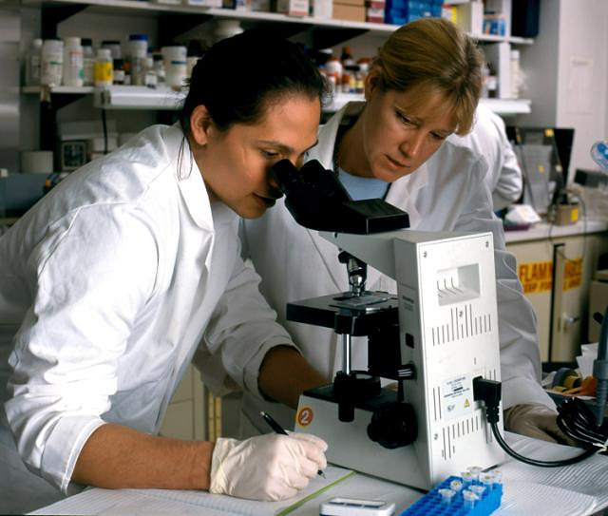
NIAID Division Resources for Researchers
DAIDS (Division of AIDS), DAIT (Division of Allergy, Immunology, and Transplantation) and DMID (Division of Microbiology and Infectious Diseases) provide access to a number of helpful Preclinical and Clinical Trial resources to help “fill gaps”, generally at no cost to investigators (award not required) including:
Therapeutic/Diagnostic and Vaccine Development Services (DMID)
Access to unique specimens and material libraries
BSL 3 and 4 Facility Access
Bioinformatics, Genomics, and other ‘Omics resources
Clinical Trial Networks (DAIDS)
Business Development Resources (DMID)
COVID-19 Specific Services
https://www.niaid.nih.gov/research/resources
Notes:
Often available without an award

Slide 94
Most Important Piece of Advice
Call or send an email to the NIAID Program Officer for feedback on your application before submission. Program Officer contact information can be found on the HHS Agency Contact webpage.
  NIAID: Dr. Natalia Kruchinin (NIAID Small Business Program Coordinator), kruchininn@niaid.nih.gov
  or
  NIAID SBIR/STTR: NIAIDSBIR@mail.nih.gov
Please include a non-confidential abstract of your technology and planned specific aims for your future project.
SUBMIT EARLY (days, not hours and minutes)!

Slide 95
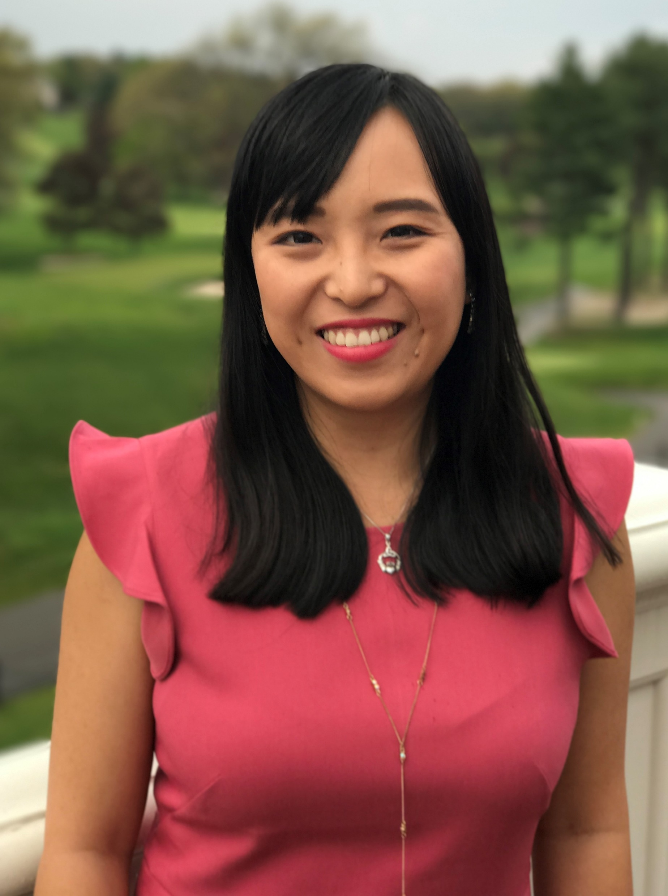
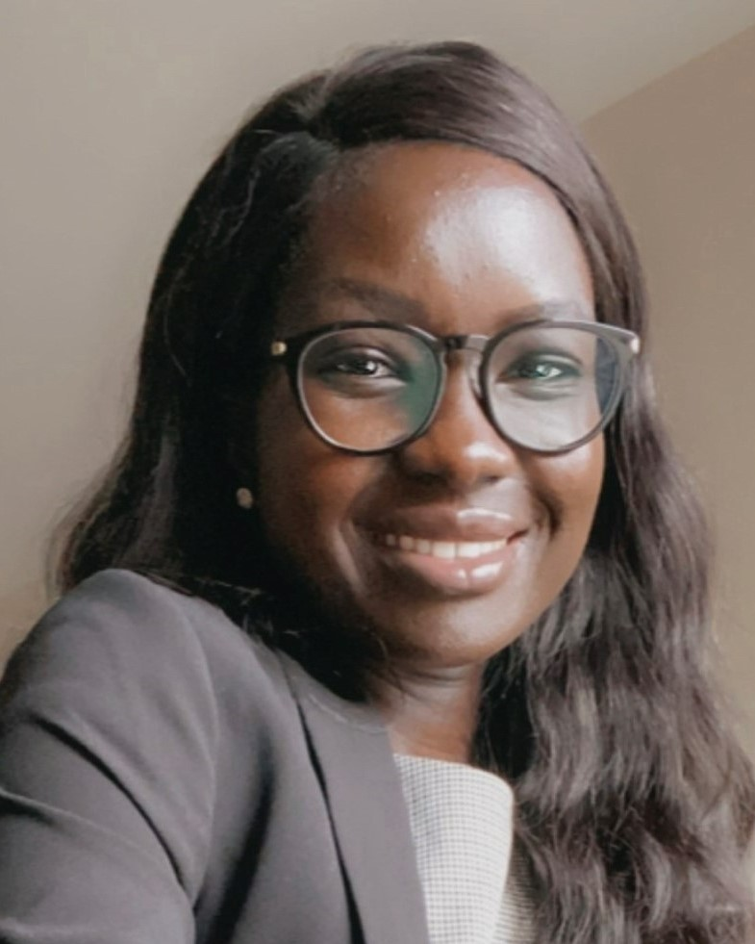
NIAID Small Business Program Team
Natalia Kruchinin, Ph.D. kruchininn@niaid.nih.gov
NIAID SBIR/STTR Program Coordinator
Patricia Roth, MS [C] patricia.roth@nih.gov
Small Business Development Specialist
Hejiao English, Ph.D. hejiao.english@nih.gov
Health Specialist
Nyamer Gatlou, [C] nyamer.gatlou@nih.gov
Small Business Development Specialist
Kenneth Kim kenneth.kim2@nih.gov
Health Specialist
Subscribe to the NIAID Small Business List-serv:
https://service.govdelivery.com/accounts/USNIAID/subscriber/new

Slide 96
National Institute of Allergy and Infectious Diseases (NIAID), NIH
Thank you!
Hejiao English, Ph.D.
Health Specialist
Small Business Program, NIAID, NIH
hejiao.english@nih.gov

Slide 97


June, 2023| TENNESSEE NCI SBIR OVERVIEW
FUNDING AND COMMERCIALIZATION RESOURCES FOR CANCER TECHNOLOGIES
Saroj Regmi, PhD
Program Director
SBIR DEVELOPMENT CENTER
NATIONAL CANCER INSTITUTE

Slide 98
NCI SBIR-Funded Portfolio
FY 2023
$203 Million
$178M – SBIR
$ 25M - STTR
Notes:
N=~500

Slide 99

THREE-PHASE PROGRAM
SBIR ONLY
DIRECT TO PHASE II
NCI SBIR PHASE IIB
BRIDGE AWARD
CROSSING THE VALLEY OF DEATH
PHASE III
PHASE I
PHASE II
FAST-TRACK (PHI I & II)
Proof-of-Concept Up to $400,000 over 6 to 12 months | Research & Development Commercialization plan required Up to $2M over 2 years | Technology validation & clinical translation Follow -on funding for SBIR Phase II awardees from any federal agencies Expectation that applicants will secure substantial 3rd party investor funds $4M over 2-3 years | Commercialization stage Use of non-SBIR/STTR funds
Notes:
Direct to Phase 2 and Fast-tracks

Slide 100
BUDGET LIMITS
 | Hard Cap | Waiver Cap*
Phase I | $295,924 | NCI: $400,000
Phase II | ~$1.97M | NCI: $2.0M
* Waiver cap is institute specific. The waiver cap listed above is for NCI only.
For the list of SBIR/STTR Waiver Topics for NCI, visit Appendix A

Slide 101
WAIVER TOPICS
Therapeutics (e.g. Small Molecules, Biologics, Radiomodulators, Cell-based Therapies and Drug Development- Related IT Tool and Algorithm Development)
In Vitro and In Vivo Diagnostics (e.g. Companion Diagnostics, Prognostic Technologies, Treatment Monitoring and Diagnostic-Related IT Tool and Algorithm Development)
Imaging Technologies (e.g. Agents, Devices, Software Tools, Algorithm Development, and Image-Guided Interventions)
Devices for Cancer Therapy (e.g. Interventional Devices, Software Tools, Algorithm Development, Surgical, Radiation and Ablative Therapies)
Agents for Cancer Prevention (e.g., Vaccines, but not “Technologies for Cancer Prevention”)
Development of Low-Cost Technologies for Low-Resource Settings and Cancer Global Health
Development of Digital Health Tools

Slide 102
FY21 GRANTS SUCCESS RATES
Grant Type (Phase I, Phase II, Fast-Track, Phase IIB, Direct-To-Phase II) | Number of Competing Applications | Number of Competing Awards
Original Submission (O1) | 1056 | 72
Resubmission (A1) | 392 | 80
Total (O1 + A1) | 1448 | 152

Slide 103
FUNDING
OPPORTUNITIES

Slide 104
FUNDING OPPORTUNITIES
TITLE | SBIR FOA | STTR FOA | RECEIPT DATES
Omnibus Solicitation | PA-22-176 (General) PA-22-177 (Clinical Trial) | PA-22-178 (General) PA-22-179 (Clinical Trial) | Standard Receipt Dates April 5; September 5; January 5
Notice of Special Interest for Cancer Prevention, Diagnosis, and Treatment Technologies for Low-Resource Settings | NOT-CA-21-062 | NOT-CA-21-062
Notice of Special Interest (NOSI): Utilization of Cohorts and Prospective Study Designs for Liquid Biopsy Assay Validation for Early Detection of Cancers | NOT-CA-23-004 | NOT-CA-23-004
Notice of Special Interest: SBIR Technology Transfer | NOT-NS-22-017
Technology Development for Single-Molecule Protein Sequencing | PAR-21-247 | No STTR | June 15, 2023
Small Business Transition Grant for Early Career Scientists | No SBIR | RFA-CA-23-035 | August 21, 2023
NCI SBIR Concept Award (Contract) | 75N91023R00034 | No STTR | August 22, 2023
NCI SBIR Phase IIB Bridge | RFA-CA-23-034 | No STTR | August 21, 2023
Contract Solicitation | Coming Soon | No STTR | TBD ~Oct./Nov. 2023

Slide 105
Small Business Transition Grant For Early Career Scientists
RFA-CA-23-035
An Entrepreneurial Training Grant Modeled After
the K99/R00
Academic
Investigator
Path
Junior Faculty
F32, K01, K25, K22
K99/R00
Tenured Faculty
R01, K24
Grad/Med Student
T32, R25, F30 (med)
Postdoctoral
T32, R25
Entrepreneur
Path
Small Biz Transition Grant
Entrepreneur
R41/R42, R43/R44

Slide 106
SMALL BUSINESS TRANSITION GRANT (SBTG):
TRANSITIONING TO ENTREPRENEURSHIP
FAST-TRACK
Phase I STTR
Transition
Phase II SBIR
TRAINING
SBC PI: Postdoc
Mentoring plan required
  Technical Mentor
  Business mentor
TECHNICAL
PI preps technology to move to SBC
I-Corps at NIH required
PERSONNEL
PI moves to SBC
TECH UPDATE
R&D Milestones
Commercialization plan
IP agreement
TRAINING
Same PI (non-transferrable)
Mentoring Continues
  Contact type and frequency in mentoring plan
TECHNICAL
Most research conducted at SBC site
Small pivots allowed
  No major scope changes
Click here for more information about SBTG
Next Receipt Date: August 21, 2023

Slide 107
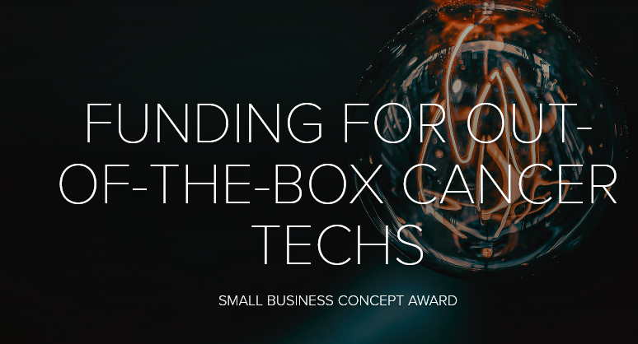
CONCEPT AWARD
DUE DATES
White Paper– May 2, 2022
Full Proposals – August 22, 2022
Phase I SBIR Contract Funding ($300K)
Focus is on innovation
Disruptive technologies to address rare and pediatric cancer
Short applications (~20 pages vs. 50)
Special review criteria with focus on innovation
Fund experiments to de-risk early-stage technologies
Make awards rapidly (within six months)
Awardees are expected to enroll in the NIH I-Corps Program
Solicitation now open: 75N91022R00006

Slide 108
CONTRACT TOPICS
The FY24 SBIR Contract Solicitation topics are now available. See below for the 11 topics that will be included in this year's solicitation.
Ultra-Fast Dose Rate (FLASH) Radiation
Technologies for Detecting Tumor-Derived Cell Clusters
Rapid and Affordable Point-of-Care HPV Diagnostics for Cervical Cancer Control
Translation of Novel Cancer-Specific Imaging Agents and Techniques to Mediate Successful Image-Guided Cancer Interventions
Microbiome-Based Tests for Cancer Research, Diagnosis, Prognosis, and/or Patient Management
Organ-on-Chip for Preclinical and Translational Radiobiological Studies
Point-of-Care Detection of Prostate Specific Antigen
Cancer Prevention and Treatment Clinical Trials Tools for Recruitment and Retention of Diverse Populations
Cloud-Based Multimodal Data Analysis Software for the Cancer Research Data Commons
Evaluation Datasets as Medical Device Development Tools for Testing Cancer Technologies
Automated Software for Point-of-Care Testing to Identify Cancer-Associated Malnutrition

Slide 109
PHASE IIB BRIDGE AWARD
DIRECT TO PHASE II
NCI SBIR PHASE IIB
BRIDGE AWARD
CROSSING THE VALLEY OF DEATH
COMMERCIALIZATION
PHASE I
PHASE II
  Provides up to $4M in additional funding over 2-3 years
  Technology validation and clinical translation
  Open to Phase II awardees from any Federal agency with projects relevant to NCI mission
  Accelerates commercialization by incentivizing partnerships with third-party investors & strategic partners earlier in the development process
  Competitive preference and funding priority to applicants that can raise substantial third-party funds (i.e., ≥ 1:1 match)
  Next Receipt Date August 22, 2023

Slide 110

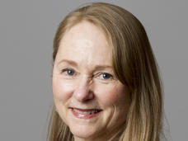

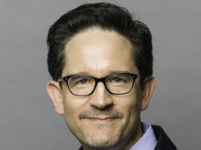
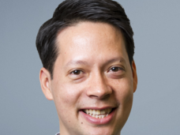
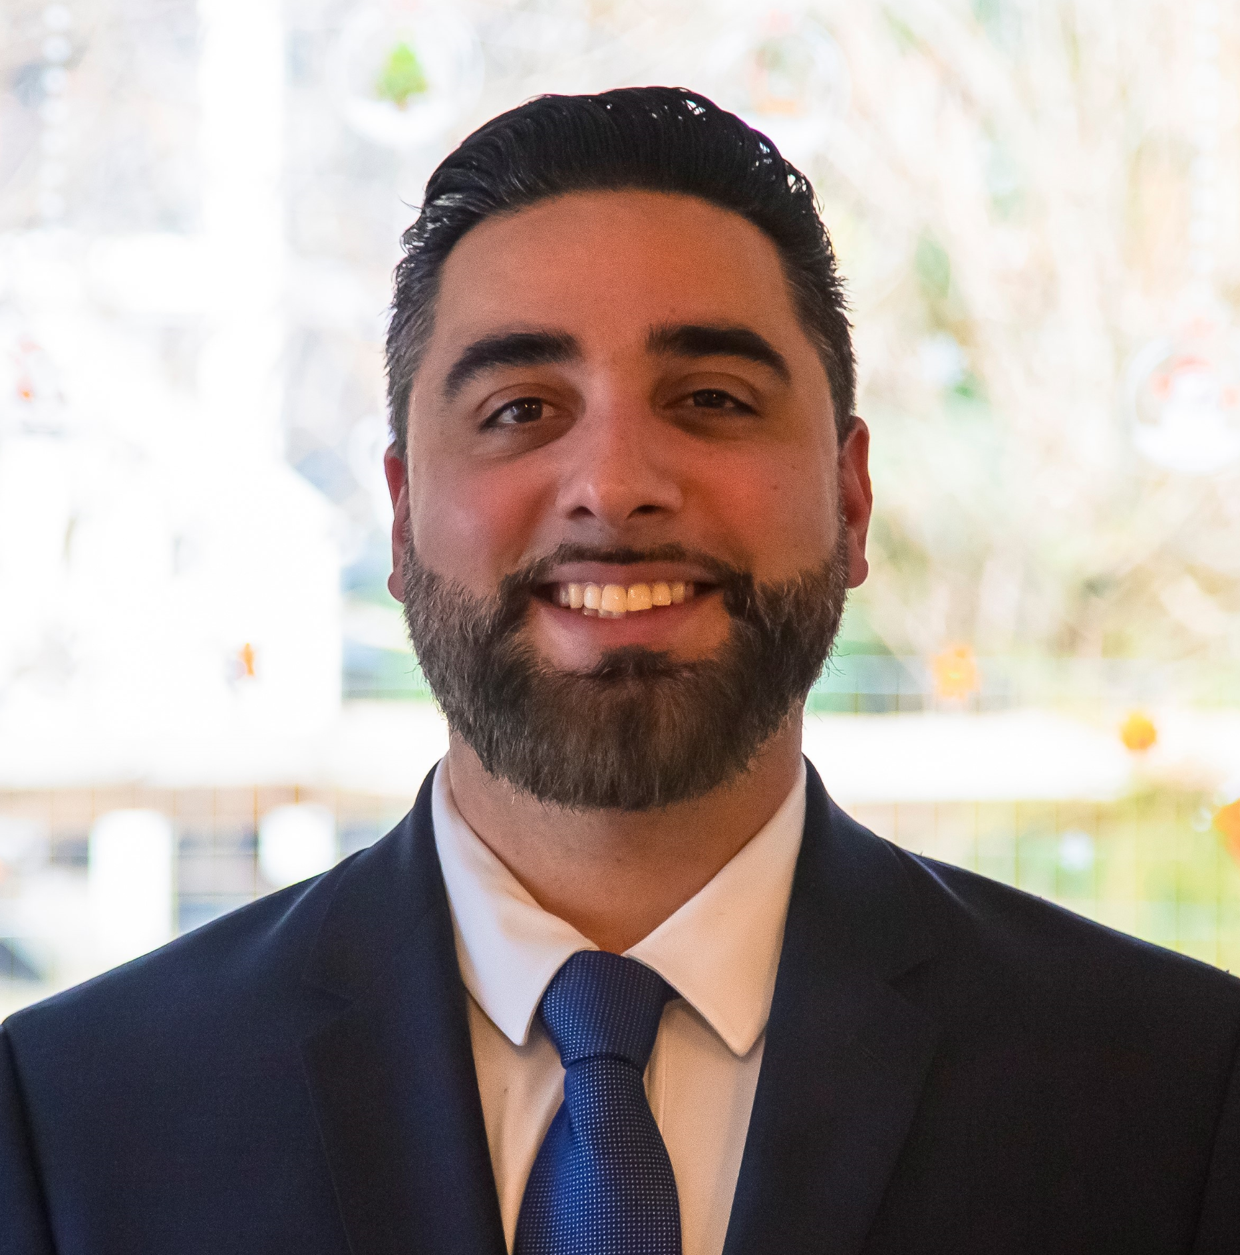
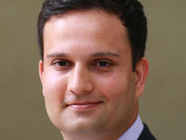
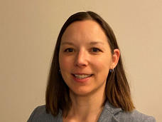


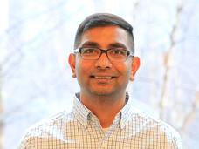
Reach Out to a Program Director
Greg Evans, PhD
Lead Program Director
Cancer Biology, E-Health, Epidemiology, Research Tools
Patricia Weber, DrPH
Program Director
Digital Health, Therapeutics, Biologics, Resources Workshop
Ming Zhao, PhD
Program Director
Cancer Diagnostics & Therapeutics, Cancer Control & Prevention, Molecular Imaging, Bioinformatics, Stem Cells
Michael Weingarten, MA
Director
NCI SBIR Development Center
https://sbir.cancer.gov/about/contact-staff
Jonathan Franca-Koh, PhD, MBA
Lead Program Director
Cancer Biology, Biologics, Small Molecules, Cell Based Therapies, Phase IIb Bridge
William Bozza, PhD
Program Director
Therapeutics, Biologics, Small Molecules, Regulatory (CMC),
Concept Award, PLAN Webinar
Saroj Regmi, PhD
Program Director
Therapeutics, Diagnostics, Imaging, Digital Health, Investor Initiatives, Small Business Transition Grant, I-Corps
Monique Pond, PhD
Lead Program Director
Biologics, Small Molecules, Therapeutic Devices, Digital Health, Regulatory Resources
Jian Lou, PhD
Program Director
In-Vitro Diagnostics, Theranostics, early-stage drug development, Bioinformatics, Investor Initiatives
Sarra Djemil, PhD
Program Director
Therapeutics & Mentoring
Swamy Tripurani, PhD
Program Director
Therapeutics, Biologics, Small Molecules, diagnostics, devices, and Regulatory (CMC and Nonclinical))

Slide 111
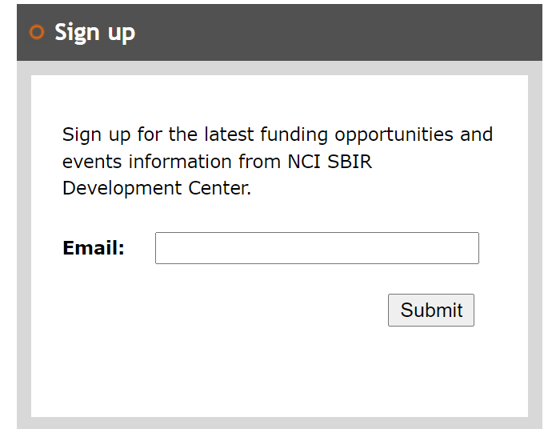
EVENTS
NCI SBIR Monthly Office Hour
  3rd Friday of each month
  Registration sheet to become available soon.
  A great opportunity to connect one-on-one with an NCI SBIR program director
  Sign up and send your 1-page technology summary to Bryce Geiling (bryce.geiling@nih.gov).
Upcoming events
  Events are listed on NCI SBIR Events Page: https://sbir.cancer.gov/newsevents/events
  Sign up for e-newsletter for the latest update: https://sbir.cancer.gov/emailsignup
Learn about our funding opportunities and resources from NCI SBIR program directors!

Slide 112

THANK YOU
CONTACT INFO
NCI SBIR DEVELOPMENT CENTER
ncisbir@mail.nih.gov
240.276.5300

Slide 113
SBIR/STTR Program at NIGMS
Eddie Billingslea
Small Business Strategy Coordinator
From Lab to Market

Slide 114
Biomedical Technology Development Programs at NIGMS
Exploratory Research/
Technology Feasibility
Iterative Technology R&D
and Validation Studies
Later Stage Technology
Development & Dissemination
Mature Technology
User Resource Commercialization
Small Business
Biomedical Technology Development and Dissemination Centers (RM1)
NIGMS National and Regional Resources (R24)
NIGMS Technology Development Programs (R21 and R01)
Small Business Innovation Research (SBIR) and Small Business Technology Transfer (STTR)

Slide 115
NIGMS Biomedical Technology Development and Dissemination Centers (RM1)
Late-Stage Technology Optimization and Validation
Technology Dissemination and Community Engagement
Technology Development Projects (TDPs)
Driving Biomedical Projects (DBPs)
Iterative Technology Development
for Robustness and Versatility

Slide 116
Phase I Feasibility Study
Phase II Full Research/R&D
$350K TC max $2.5M TC max
Discovery
Phase I
Development
Phase II
Feasibility
RD/Commercialization
Phase I Phase II
Fast-Track
Direct to Phase II
SBIR only

Slide 117
NIGMS SBIR/STTR Topics of Interest
  Division of Biophysics, Biomedical Technology, and Computational Biosciences (BBCB)
    Scientific instrumentation, Devices, Methods, Research Reagents
    Computational technologies, Data Science, Bioinformatics
    Platform technologies for basic science research, Omics
  Division of Pharmacology, Physiology, Biological Chemistry (PPBC)
    Platform technologies for drug discovery/evaluation
    Medicinal chemistry
    Anesthesiology, Wound healing, Sepsis
  Training, Workforce Development, and Diversity (TWD)
    Products and services to enhance scientific workforce diversity and development
  Division of Research Capacity Building (DRCB)
    Health education
    Science Education Partnership Awards

Slide 118
Currently Active SBIR Funding Opportunities NIGMS participates
SBIR/STTR Omnibus Solicitation
Interactive Digital Media STEM Resources for Pre-College and Informal Science Education Audiences
Development of Highly Innovative Tools and Technology for Analysis of Single Cells
SBIR/STTR Commercialization Readiness Pilot (CRP) Program Technical Assistance
Administrative Supplements to Promote Diversity in Small Businesses-SBIR/STTR (PA-21-345)
Notice of Special Interest: NIGMS Priorities for Small Business Development of Sepsis Diagnostics and Therapeutics (NOT-GM-20-028)
Notice of Special Interest: Administrative Supplement for Providing Technical and Business Assistance (TABA) to SBIR/STTR Awardees (NOT-OD-21-062)

Slide 119
NIGMS SBIR/STTR Oversight Group (SOG)
GAB SBIR/STTR Coordinators– Brian Iglesias, Ilene Glassman, Alania Foster
Biophysics, Biomedical Technology, and Computational Biosciences (BBCB) – Ashley Barnes
Pharmacology, Physiology, and Biological Chemistry (PPBC) – Sailaja Koduri
Training, Workforce Development, and Diversity (TWD) – Sailaja Koduri
Research Capacity Building (DRCB) – Krishan Arora
Science Education Partnership Award (SEPA) – Tony Beck
Small Business Strategy Coordinator—Eddie Billingslea

Slide 120
QUESTIONS?

Slide 121

COFFEE BREAK

